Slide 1
Psychometrics and Structural Equation Modeling
Course Introduction, Classical Test Theory & Beyond

Slide 2
Lecture overview
Overview of Course Organization
Measurement and Test Construction
Classical Test Theory
Coarse Categorization
PCA & Factor Analysis
Principal Components Analysis
Exploratory Factor Analysis
Confirmatory Factor Analysis
Factor-based Classical Test Theory

Slide 3
Course Organization

Slide 4


Lecturers
Weeks 4-6: Hannelies de Jonge
Specialization: Structural Equation Modeling, Meta-analysis
Week 1-3: Marjolein Fokkema
Specialization: Statistical Learning & Prediction, Psychometrics, Structural Equation Modeling, Multilevel Models
Methodology and Statistics Department
Institute of Psychology, Pieter de la Court Building, Wassenaarseweg 52.

Slide 5
Team
Lecturer: Marjolein Fokkema (m.fokkema@fsw.leidenuniv.nl)
Questions about lectures week 1-3
Assistant: Ligaya Breemer (l.breemer@fsw.leidenuniv.nl)
Questions about working groups and exercises of week 1-3
Questions about data assignment 1 and evaluation of data assignment 1
Lecturer and course coordinator: Hannelies de Jonge (h.de.jonge@fsw.leidenuniv.nl)
Questions about lectures week 4-6
All other questions
Questions about exam
Assistant: Aditi Bhangale (a.m.bhangale@fsw.leidenuniv.nl)
Questions about working groups and exercises of week 4-6
Questions about data assignment 2 and evaluation of data assignment 2
We try to answer as soon as possible. If you do not respond in 3 working days, you can send a friendly reminder. Please do not email multiple team members with the same question.

Slide 6
Course Content
Part I (week 1): Classical Test Theory and Measurement
Part II (weeks 2-3): Item Response Theory
Part III (weeks 4-6): Structural Equation Modeling and Modern Approaches to Measurement

Slide 7
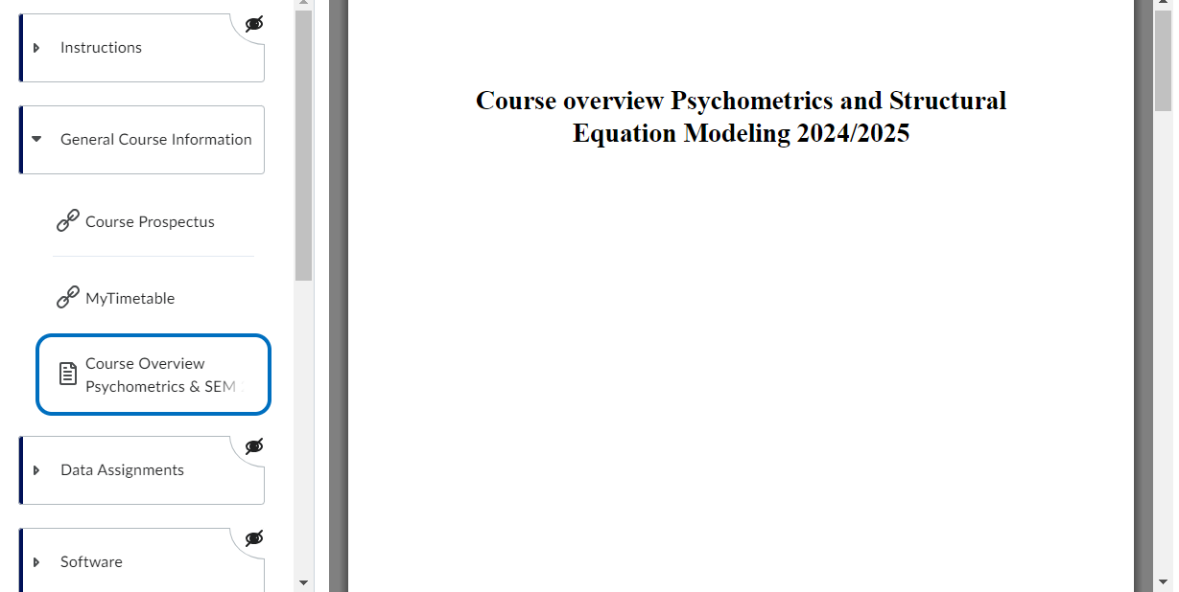
Course info (is on Brightspace)

Slide 8
Course Structure
Weekly:
Before lecture: Reading materials
Lecture: Wednesday
Exercises: Released following lecture
Workgroup: Friday
2 take-home assignments:
2 throughout the course
Final Exam:
Written, in-person exam, open-ended questions
Covers entire course, questions will build on the weekly exercises and data assignments although there is no guarantee that all exam question will be covered directly or indirectly in exercises.

Slide 9
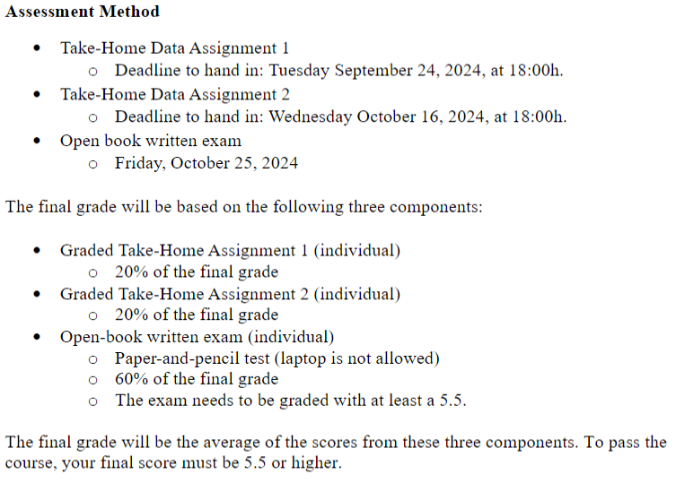
Grading

Slide 10
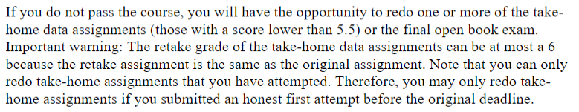
Resits

Slide 11
Readings and Exercises
Given the breadth of topics, we do not rely on a single book or course pack
Readings will be provided for each week’s lecture on Brightspace
Will include book chapters, refereed articles, and other reference material
Exercises will provide weekly practice and help prepare for the exam
Answers/solutions provided to exercises at the end of each week
Workgroups are for working on exercises, asking additional help and explanation
While in principle, students may use alternative software, but support for this course will be in R:
lavaan (Rosseel, 2012; https://lavaan.ugent.be/) will be our primary SEM software
R packages for other sections will be specified where necessary

Slide 12
Psychometrics and Structural Equation Modeling
Measurement and Test Construction

Slide 13
A (Brief) History of Measurement

Slide 14
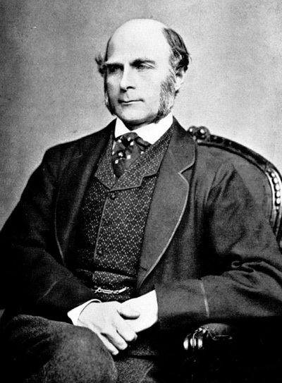
(Brief) History of Measurement
“Until the phenomena of any branch of knowledge have been subjected to measurement and numbers, it cannot assume the status of dignity of a science”
--Galton (1879)
Psychometric Experiments

Slide 15
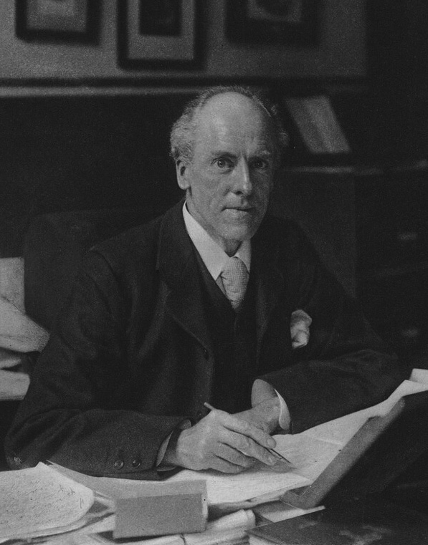
Karl Pearson (1902):
“On the Inheritance of the Mental Characters in Man”
“On the Correlation of Intellectual Ability with the Size and Shape of the Head”

Slide 16
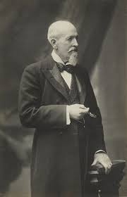
Spearman (1904):
Tests measure a single psychological attribute a ‘common factor’ (factor analysis).
Test score is the composed of a ‘true score’ and ‘error of measurement’ (classical test theory).

Slide 17
(Brief) History of Measurement
Measurement is the principled assignment of numbers to observations
Nothing in nature comes with a numerical label
Measurement involves distilling the features of the world into numerical quantities
These quantities need to map onto the phenomenon in principled ways
Desirable features in measurement
Preservation of rank order (e.g., higher numbers reflect more of a phenomenon)
Measuring repeatedly should yield the same result (may depend on context)
Changes in the phenomenon should lead to commensurate changes in the measurement
Ideal: A given amount of change in the phenomenon should lead to equal magnitude changes in the measurement (not always possible)
We will discuss how we formalize these features throughout the course

Slide 18
(Brief) History of Measurement
Compared to the physical sciences, measurement in psychology, education, and other social sciences is often more indirect
E.g., math ability, health of the economy, level of depression/anxiety
Often greater sources of error and noise in these measurements
We often rely on tests for measuring these constructs of interest
History stretching back thousands of years to civil service exams in Zhou Dynasty China and citizenship tests in Ancient Greece
Rather than relying on a single observed quantity (e.g., length), we instead construct a set of items which together allow us to measure the construct by aggregation

Slide 19
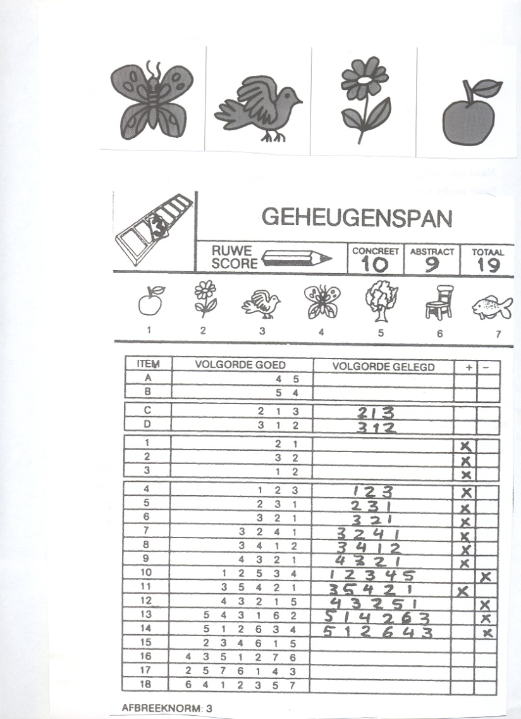
(Brief) History of Measurement
E.g., on a memory test, we ask students to complete multiple items of varying difficulty
No one answer is “memory span” on its own, but aggregating responses on each item can give us an overall score that reflects every individuals’ memory span
Tests can use different response types
Correct/incorrect (we will start here)
Ordinal (e.g., ‘Likert’ scales)
Continuous responses

Slide 20
Properties of Tests
Tests consist of a set of items with a standard format
With objective tests, responses are scored automatically
Responses have defined empirical relationships (e.g., correct/incorrect, % of total)
Responses are assigned numbers based on these empirical relationships
Response to different items reflects the same construct or attribute
Items’ scores are combined in a principled way to give a test score

Slide 21
How Tall Are You?

Slide 22
How Tall Are You?

Slide 23
Considerations when Constructing a Test
Does the test capture one construct/attribute or several? (dimensionality)
Does the test measure what we think it is measuring? (validity)
Not always a given!

Slide 24
Considerations when Constructing a Test
Does the test capture one construct/attribute or several? (dimensionality)
Does the test measure what we think it is measuring? (validity)
How should items be scored to obtain the test score?
Reverse coded items, weighting for difficulty, etc.
How precisely does the test measure the attribute? (reliability)
How does the precision of the test vary across levels of the attribute? (information)
Can we make alternative tests that equivalently measure the same attribute? (equating)
Can we adaptively present the items to each individual to gain more optimal (more precise, faster) results?

Slide 25
Considerations when Constructing a Test
Does the test capture one construct/attribute or several? (dimensionality)
Does the test measure what we think it is measuring? (validity)
How should items be scored to obtain the test score?
Reverse coded items, weighting for difficulty, etc.
How precisely does the test measure the attribute? (reliability)
How does the precision of the test vary across levels of the attribute? (information)
Can we make alternative tests that equivalently measure the same attribute? (equating)
Can we adaptively present the items to each individual to gain more optimal (more precise, faster) results?
We will keep these considerations in mind across all methods we discuss in this course. Most of them have statistical definitions that we can optimize for.

Slide 26
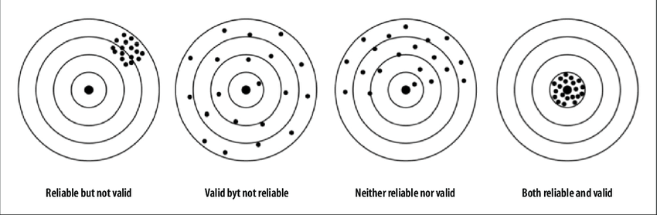
Reliability and validity
Resembles bias-variance trade-off
(lack of) Reliability corresponds to variance (random distrurbances)
(lack of validity) corresponds to bias (systematic disturbances)
McD (Ch5) writes about Reliability, Validity and Generalizability. In my opinion, both of the latter two are validity.

Slide 27
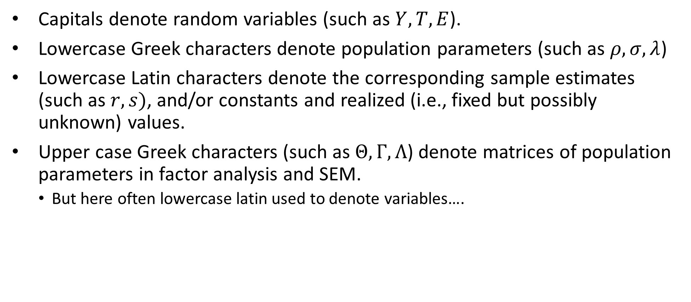
Notation
Capitals denote random variables (such as $Y,T,E$).
Lowercase Greek characters denote population parameters (such as $ρ, σ, λ$)
Lowercase Latin characters denote the corresponding sample estimates (such as $r, s)$, and/or constants and realized (i.e., fixed but possibly unknown) values.
Upper case Greek characters (such as $Θ, Γ,Λ$) denote matrices of population parameters in factor analysis and SEM.
But here often lowercase latin used to denote variables….

Slide 28
Classical Test Theory

Slide 29
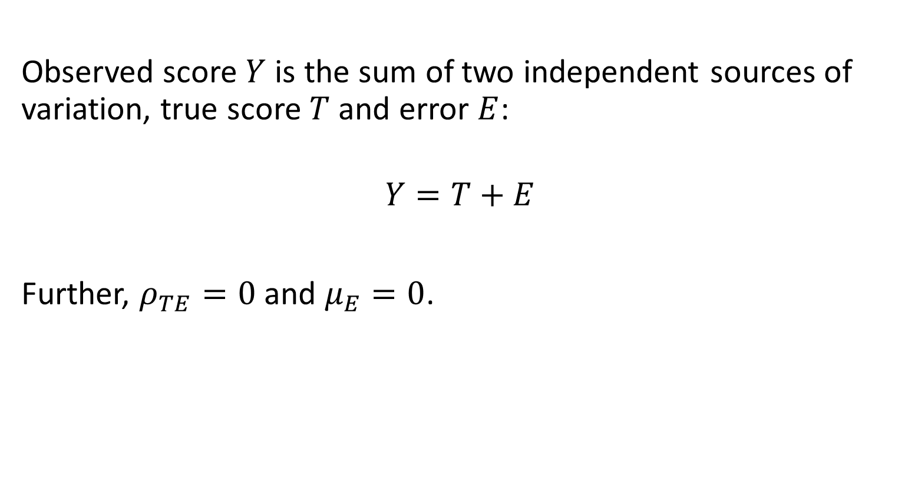
Classical Test Theory
Observed score $Y$ is the sum of two independent sources of variation, true score $T$ and error $E$:
$$Y=T+E$$
Further, $ρ_{TE}=0$ and $μ_{E}=0$.
Notes:
What can we derive from this? Rho_YT and rho_YE are equal to or great than 0, mu of Y = my of T. Further?

Slide 30

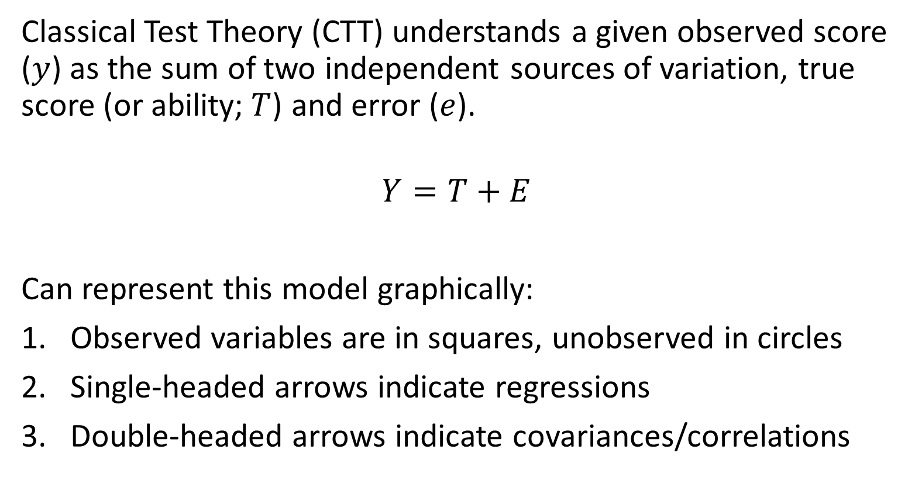


Classical Test Theory: Graphical Representation
Classical Test Theory (CTT) understands a given observed score ($y$) as the sum of two independent sources of variation, true score (or ability;$T$) and error ($e$).
$$Y=T+E$$
Can represent this model graphically:
Observed variables are in squares, unobserved in circles
Single-headed arrows indicate regressions
Double-headed arrows indicate covariances/correlations
$$T$$
$$Y$$
$$E$$

Slide 31
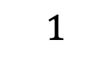
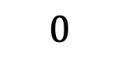
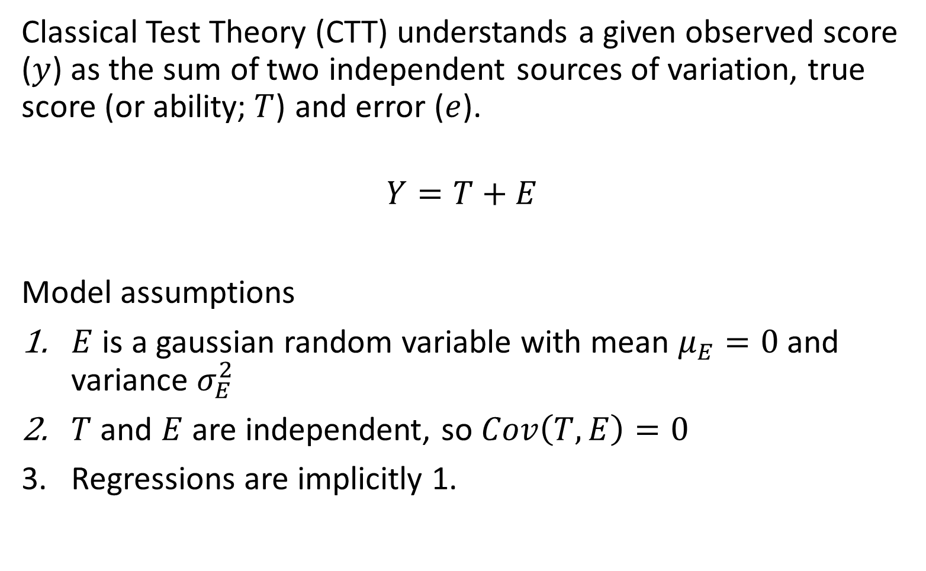
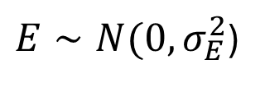
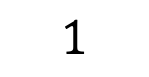
Classical Test Theory: Assumptions
Classical Test Theory (CTT) understands a given observed score ($y$) as the sum of two independent sources of variation, true score (or ability;$T$) and error ($e$).
$$Y=T+E$$
Model assumptions
$E$ is a gaussian random variable with mean $μ_{E}=0$and variance $σ_{E}^{2}$
$T$ and $E$ are independent, so $Cov\left(T,E\right)=0$
Regressions are implicitly 1.
$$T$$
$$1$$
$$Y$$
$$0$$
$$1$$
$$E$$
$E∼N(0,σ_{E}^{2}$)

Slide 32
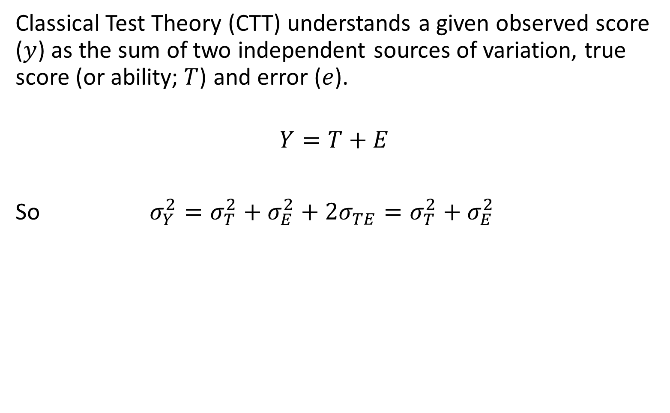
Classical Test Theory: Assumptions
Classical Test Theory (CTT) understands a given observed score ($y$) as the sum of two independent sources of variation, true score (or ability;$T$) and error ($e$).
$$Y=T+E$$
So $σ_{Y}^{2}=σ_{T}^{2}+σ_{E}^{2}+2σ_{TE}=σ_{T}^{2}+σ_{E}^{2}$
$$T$$
$$1$$
$$Y$$
$$0$$
$$1$$
$$E$$
$E∼N(0,σ_{E}^{2}$)

Slide 33
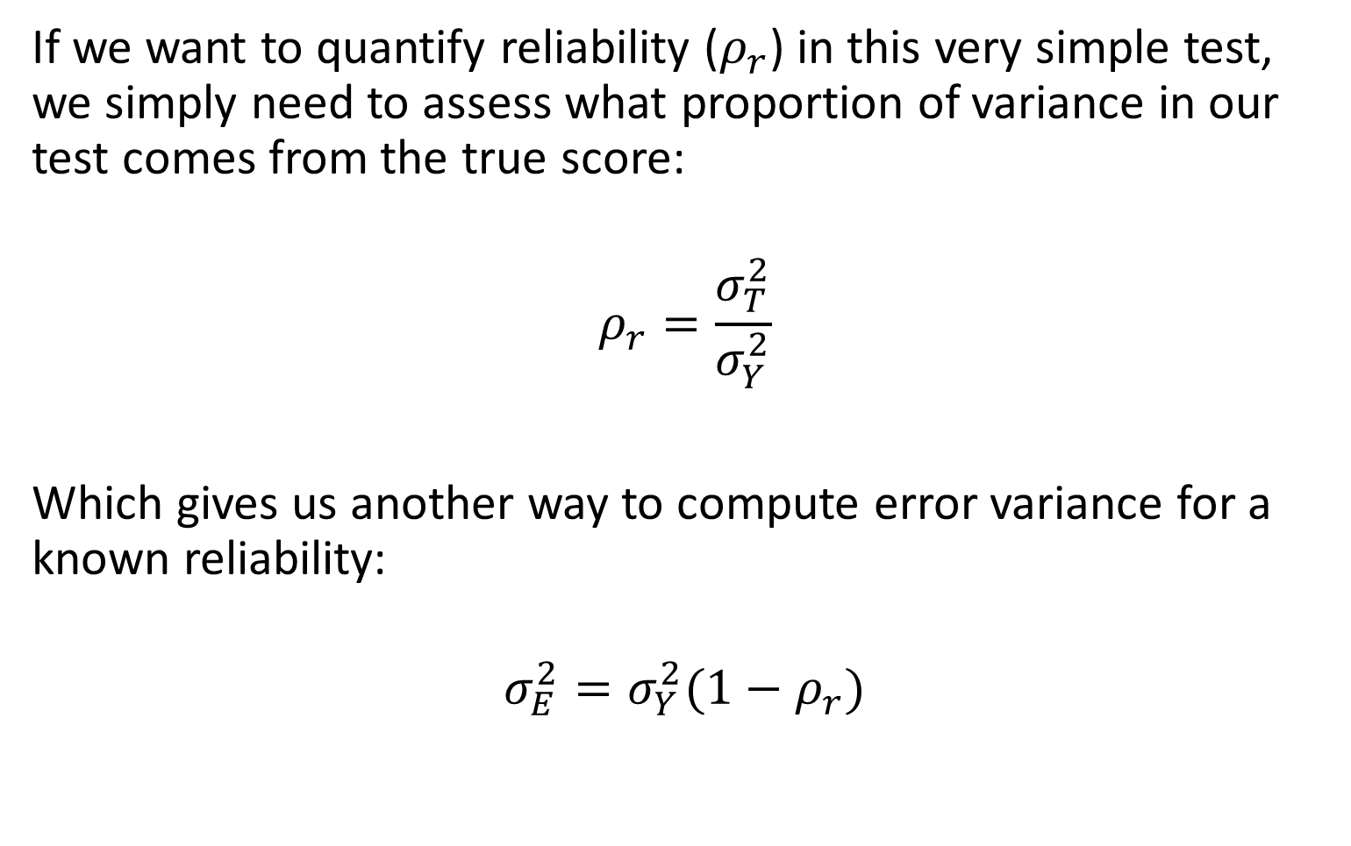
Classical Test Theory: Single-Item Test Reliability
If we want to quantify reliability ($ρ_{r}$) in this very simple test, we simply need to assess what proportion of variance in our test comes from the true score:
$$ρ_{r}=\frac{σ_{T}^{2}}{σ_{Y}^{2}}$$
Which gives us another way to compute error variance for a known reliability:
$$σ_{E}^{2}=σ_{Y}^{2}(1−ρ_{r})$$
$$T$$
$$1$$
$$Y$$
$$0$$
$$1$$
$$E$$
$E∼N(0,σ_{E}^{2}$)

Slide 34
Classical Test Theory: Single-Item Test
This model is incredibly simple, but the same principles will apply as we increase the size and dimensionality of our test.
The graphical representation will return when we move into factor analytic approaches and SEM, so remember the conventions
$$T$$
$$1$$
$$Y$$
$$0$$
$$1$$
$$E$$
$E∼N(0,σ_{E}^{2}$)

Slide 35
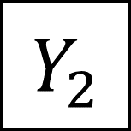
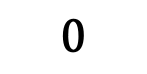

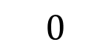
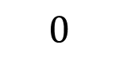
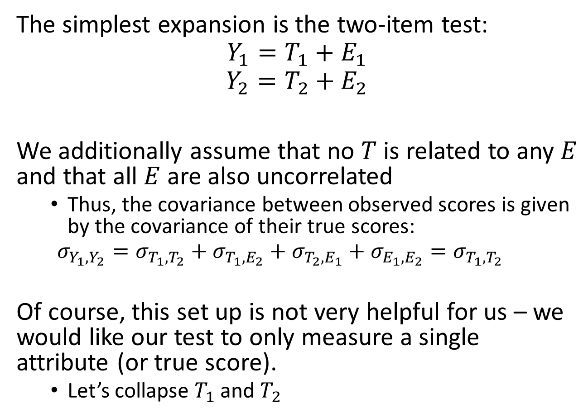
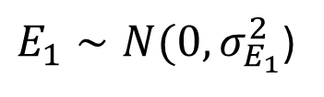
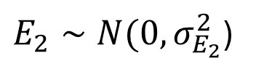



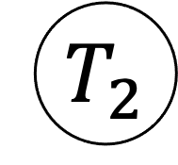
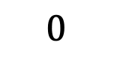
Classical Test Theory: Multiple-Item Test
The simplest expansion is the two-item test:
$$Y_{1}=T_{1}+E_{1}$$
$$Y_{2}=T_{2}+E_{2}$$
We additionally assume that no $T$ is related to any $E$ and that all $E$are also uncorrelated
Thus, the covariance between observed scores is given by the covariance of their true scores:
$$σ_{Y_{1},Y_{2}}=σ_{T_{1},T_{2}}+σ_{T_{1},E_{2}}+σ_{T_{2},E_{1}}+σ_{E_{1},E_{2}}=σ_{T_{1},T_{2}}$$
Of course, this set up is not very helpful for us – we would like our test to only measure a single attribute (or true score).
Let’s collapse $T_{1}$ and $T_{2}$
$$T_{1}$$
$$T_{2}$$
$$Y_{1}$$
$$Y_{2}$$
$$0$$
$$0$$
$$0$$
$$0$$
$$E_{1}$$
$$E_{2}$$
$$0$$
$E_{1}∼N(0,σ_{E_{1}}^{2}$)
$E_{2}∼N(0,σ_{E_{2}}^{2}$)
35

Slide 36
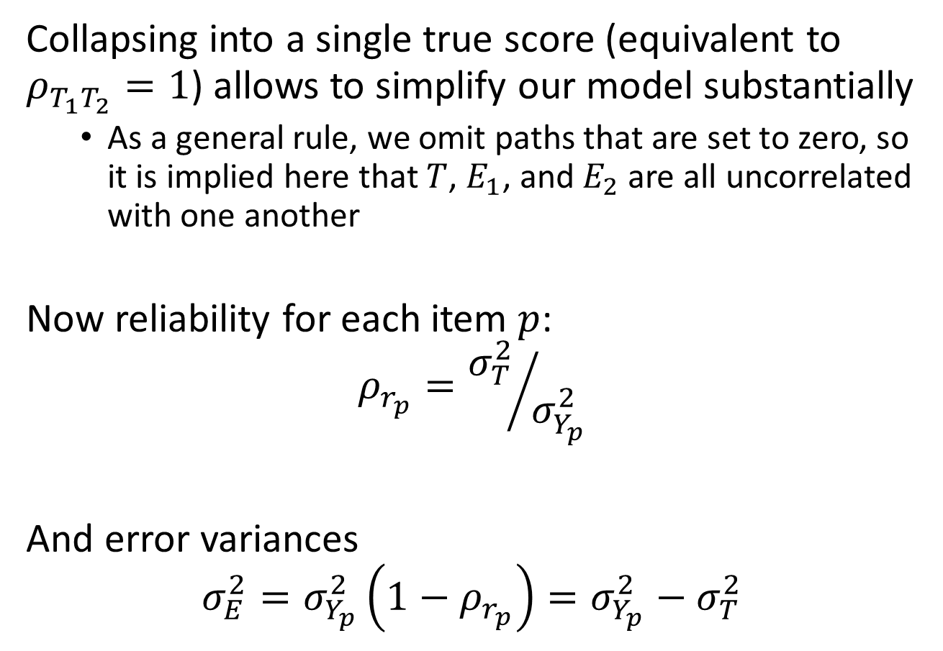

Classical Test Theory: Multiple-Item Test
Collapsing into a single true score (equivalent to $ρ_{T_{1}T_{2}}=1$) allows to simplify our model substantially
As a general rule, we omit paths that are set to zero, so it is implied here that $T$, $E_{1}$, and $E_{2}$ are all uncorrelated with one another
Now reliability for each item $p$:
$$ρ_{r_{p}}={σ_{T}^{2}}/{σ_{Y_{p}}^{2}}$$
And error variances
$$σ_{E}^{2}=σ_{Y_{p}}^{2}\left(1−ρ_{r_{p}}\right)=σ_{Y_{p}}^{2}−σ_{T}^{2}$$
$$T$$
$$Y_{1}$$
$$Y_{2}$$
$$E_{1}$$
$$E_{2}$$
$E_{1}∼N(0,σ_{E_{1}}^{2}$)
$E_{2}∼N(0,σ_{E_{2}}^{2}$)
36

Slide 37
Classical Test Theory: Multiple-Item Test
The assumption of a single true score greatly simplifies and is the reason we develop (and assume) tests to assess only a single dimension (very useful assumptions, probably never true).
So far, these diagrams are largely conceptual tools, but later we will turn them into statistical objects.
In principle, this extends to as many items as we need.
$$T$$
$$Y_{1}$$
$$Y_{2}$$
$$E_{1}$$
$$E_{2}$$
$E_{1}∼N(0,σ_{E_{1}}^{2}$)
$E_{2}∼N(0,σ_{E_{2}}^{2}$)
37

Slide 38
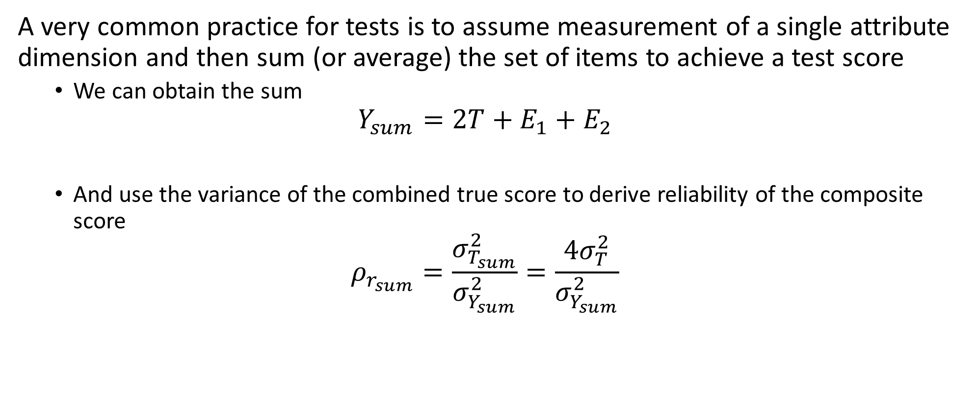
Classical Test Theory: Sum Scores
A very common practice for tests is to assume measurement of a single attribute dimension and then sum (or average) the set of items to achieve a test score
We can obtain the sum
$$Y_{sum}=2T+E_{1}+E_{2}$$
And use the variance of the combined true score to derive reliability of the composite score
$$ρ_{r_{sum}}=\frac{σ_{T_{sum}}^{2}}{σ_{Y_{sum}}^{2}}=\frac{4σ_{T}^{2}}{σ_{Y_{sum}}^{2}}$$

Slide 39
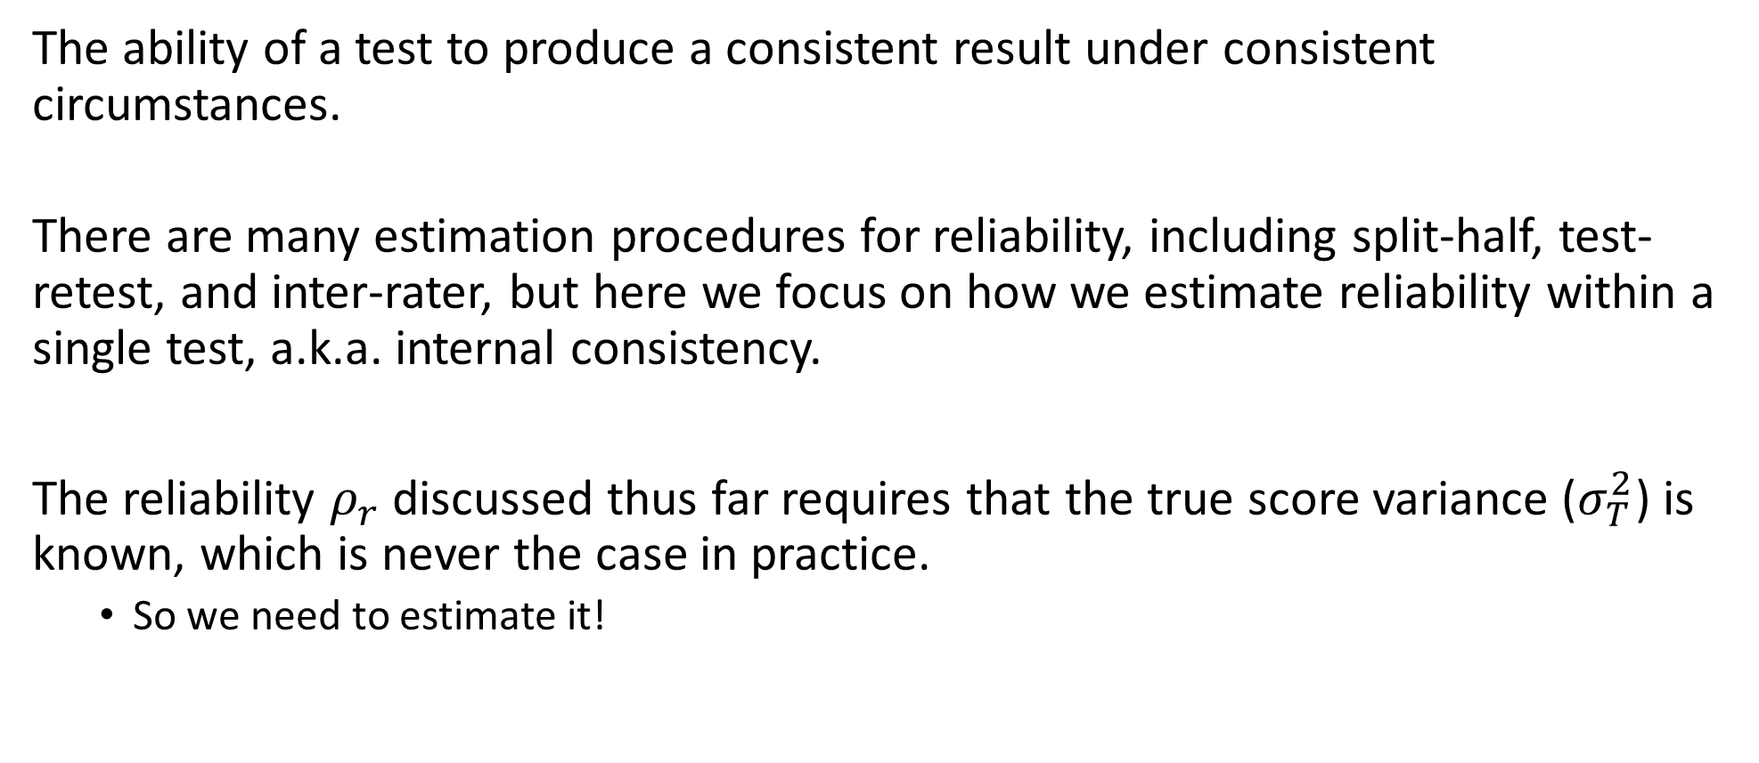
Reliability
The ability of a test to produce a consistent result under consistent circumstances.
There are many estimation procedures for reliability, including split-half, test-retest, and inter-rater, but here we focus on how we estimate reliability within a single test, a.k.a. internal consistency.
The reliability $ρ_{r}$ discussed thus far requires that the true score variance ($σ_{T}^{2}$) is known, which is never the case in practice.
So we need to estimate it!

Slide 40
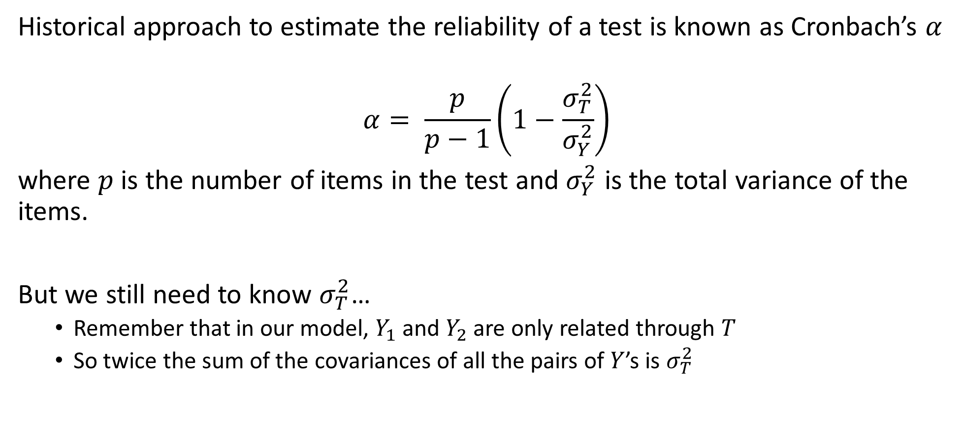
Cronbach’s Alpha
Historical approach to estimate the reliability of a test is known as Cronbach’s $α$
$$α= \frac{p}{p−1}\left(1−\frac{σ_{T}^{2}}{σ_{Y}^{2}}\right)$$
where $p$ is the number of items in the test and $σ_{Y}^{2}$ is the total variance of the items.
But we still need to know $σ_{T}^{2}$…
Remember that in our model, $Y_{1}$ and $Y_{2}$ are only related through $T$
So twice the sum of the covariances of all the pairs of $Y$’s is $σ_{T}^{2}$

Slide 41
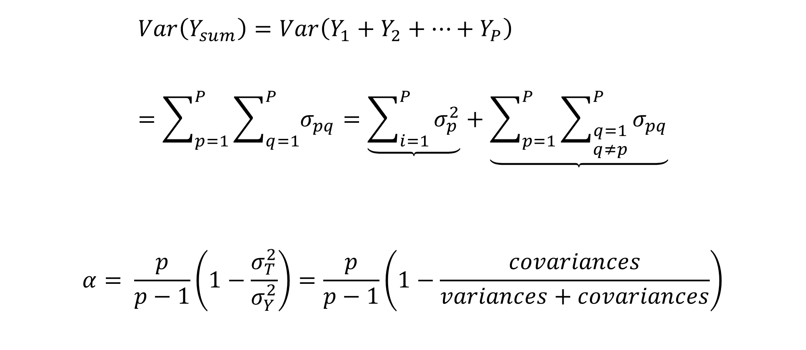
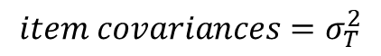
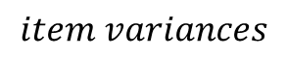
Cronbach’s Alpha
$$Var\left(Y_{sum}\right)=Var\left(Y_{1}+Y_{2}+…+Y_{P}\right) \\ =\sum_{p=1}^{P}{\sum_{q=1}^{P}{σ_{pq}}}=\underbrace{\sum_{i=1}^{P}{σ_{p}^{2}}}+\underbrace{\sum_{p=1}^{P}{\sum_{\begin{aligned}q=1 \\ q≠p\end{aligned}}^{P}{σ_{pq}}}}$$
$$α= \frac{p}{p−1}\left(1−\frac{σ_{T}^{2}}{σ_{Y}^{2}}\right)=\frac{p}{p−1}\left(1−\frac{covariances}{variances+covariances}\right)$$
$$item variances$$
$$item covariances=σ_{T}^{2}$$
Notes:
Refer to general form of variance of sums of variables (e.g. https://stats.stackexchange.com/a/577217/173546)

Slide 42
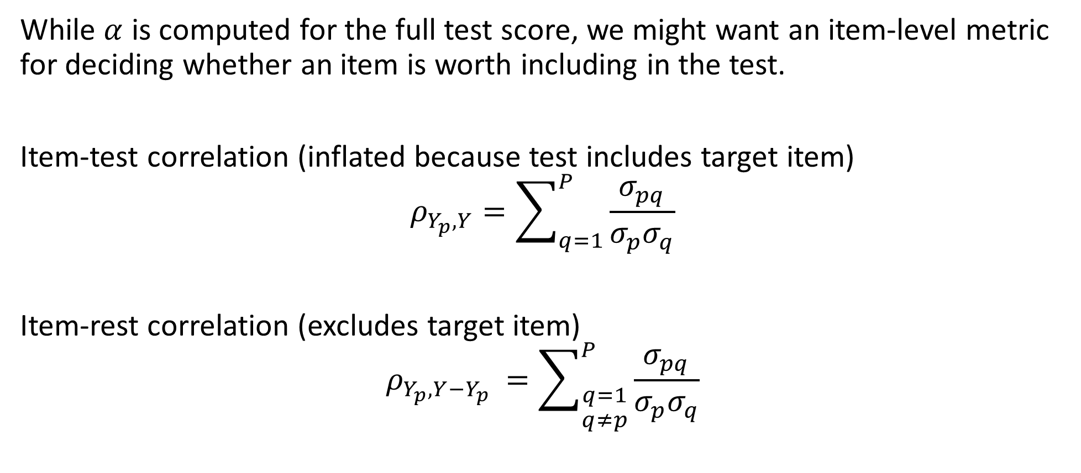
Item-level analysis
While $α$ is computed for the full test score, we might want an item-level metric for deciding whether an item is worth including in the test.
Item-test correlation (inflated because test includes target item)
$$ρ_{Y_{p},Y}=\sum_{q=1}^{P}{\frac{σ_{pq}}{σ_{p}σ_{q}}}$$
Item-rest correlation (excludes target item)
$$ρ_{Y_{p},Y−Y_{p} }=\sum_{\begin{aligned}q=1 \\ q≠p\end{aligned}}^{P}{\frac{σ_{pq}}{σ_{p}σ_{q}}}$$

Slide 43
How Tall Are You?

Slide 44
How Tall Are You?

Slide 45
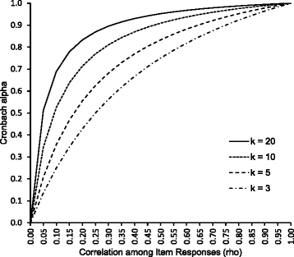
Some notes on reliability
Many factors can influence reliability estimates
Increasing test length and inter-item correlations (tend to) increase reliability
Large differences in item difficulty, and multi-dimensionality (tend to) reduce reliability

Slide 46
Some notes on reliability
Many factors can influence reliability estimates
Increasing test length and inter-item correlations (tend to) increase reliability
Large differences in item difficulty, and multi-dimensionality (tend to) reduce reliability
Test length is often a major concern in psychometric models
Need to balance obtaining reliable results with student/participant burden
Challenge of building items that are unique yet still capture the same unidimensional attribute

Slide 47
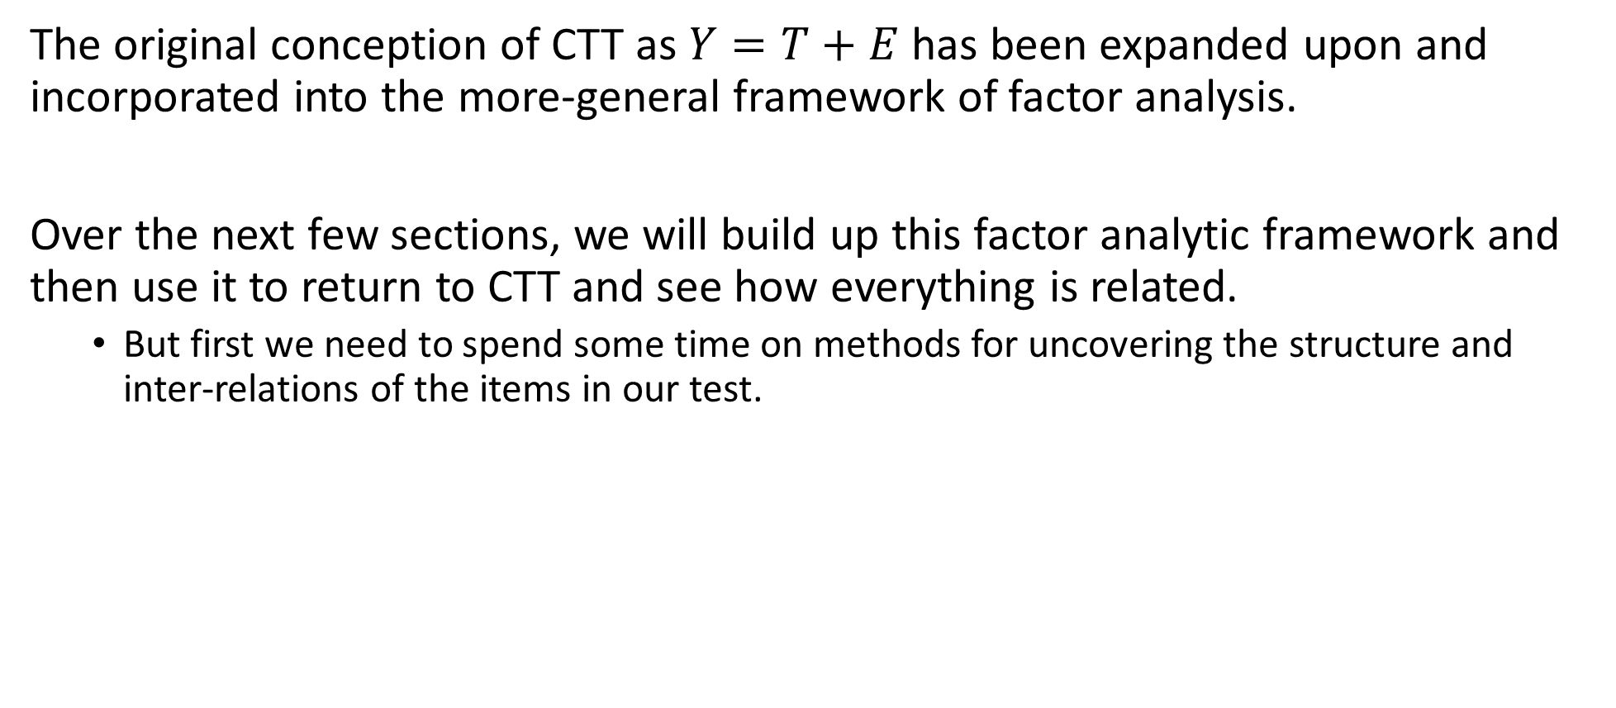
An Updated View of CTT
The original conception of CTT as $Y=T+E$ has been expanded upon and incorporated into the more-general framework of factor analysis.
Over the next few sections, we will build up this factor analytic framework and then use it to return to CTT and see how everything is related.
But first we need to spend some time on methods for uncovering the structure and inter-relations of the items in our test.

Slide 48
Coarse Categorization

Slide 49
Coarse Categorization
Relates to both:
Measurement: Quantification of attributes of objects or events according to rules, which can be used to compare with other objects or events.
Scaling: Choosing a metric. The choice of the set of numbers to assign to the possible observations.
Often, a distinction is made between different levels of measurement
Continuous > ordered categories > categorical
Many classic approaches to measurement assume continuous items where (co)variances are the unit of analysis (e.g., reliability)
However, not all continuous measures are created equally
A 1-5 scale vs 1-10 or 1-100 scale
Respondents (and test developers) tend to stick with extremes, integer or “round” numbers, etc.

Slide 50
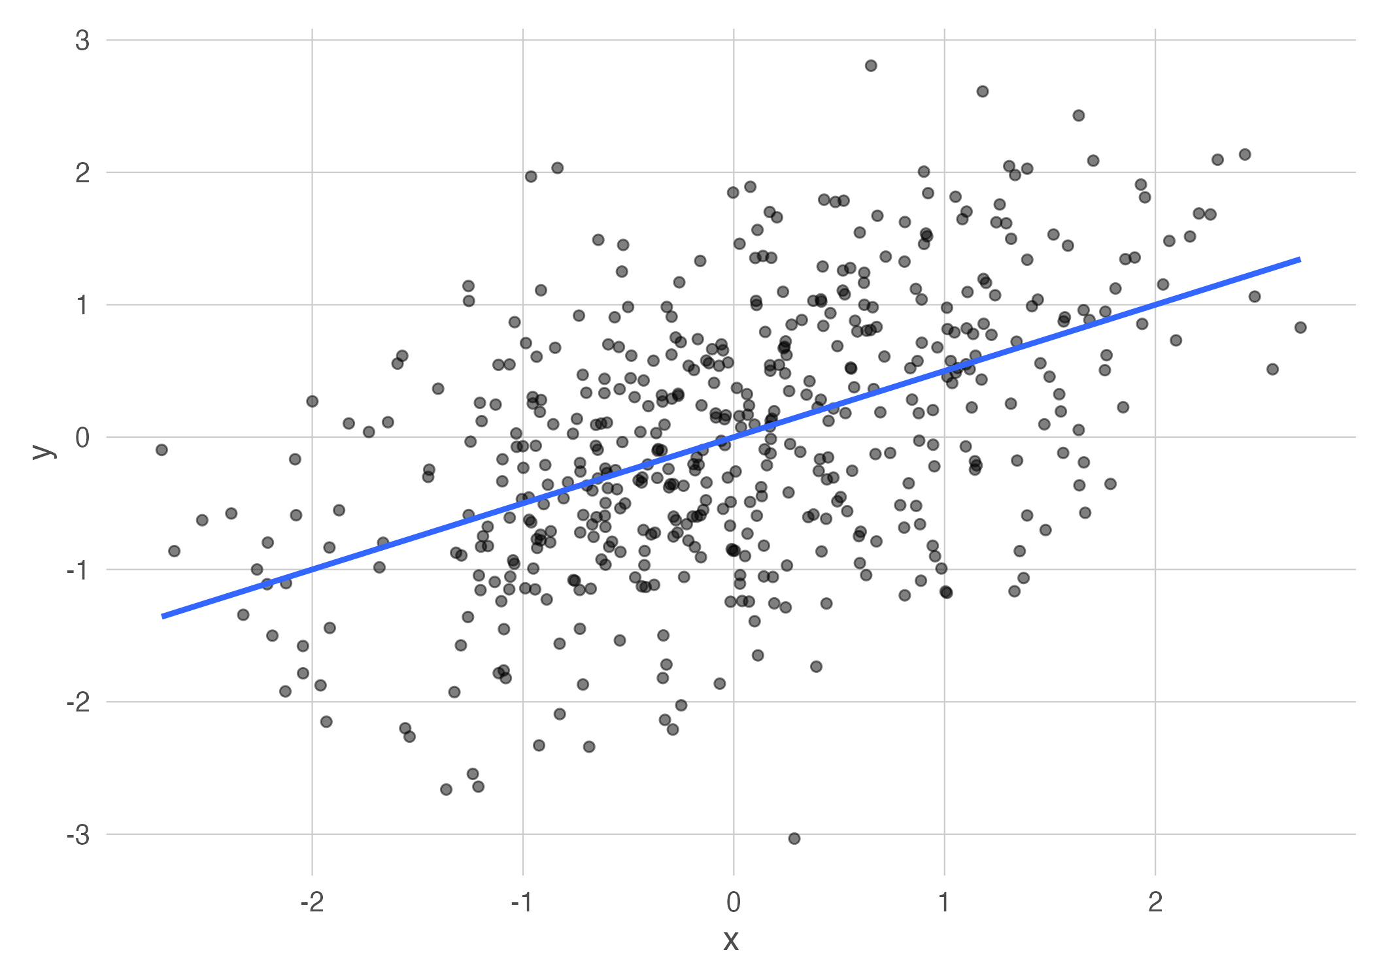
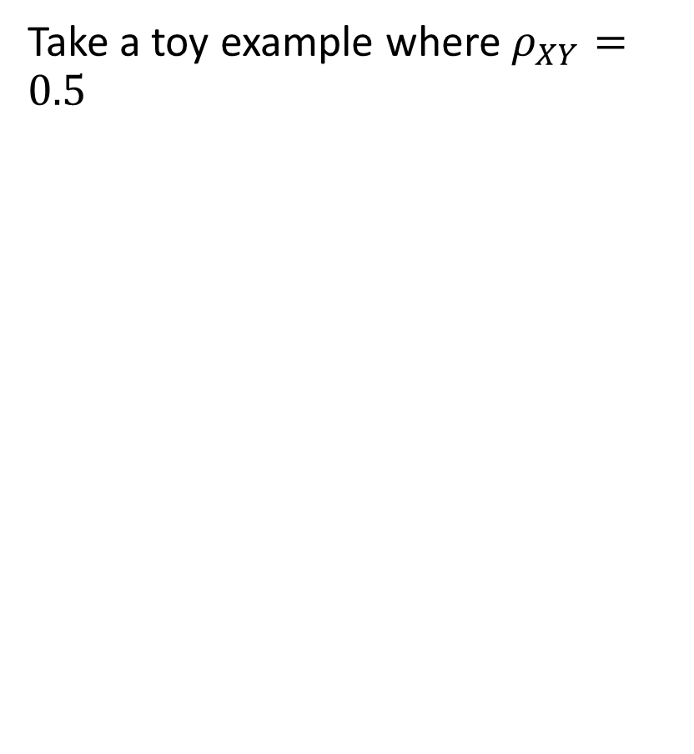
Coarse Categorization
Take a toy example where $ρ_{XY}=0.5$
Imposing categories on the data steadily decreases the Pearson correlation (red) until a binary variable has ${\hat{ρ}}_{xy}=0.325$
Coarse categorization will degrade estimates of effects and reliability (all covariance-based)
Impacts all models!

Slide 51
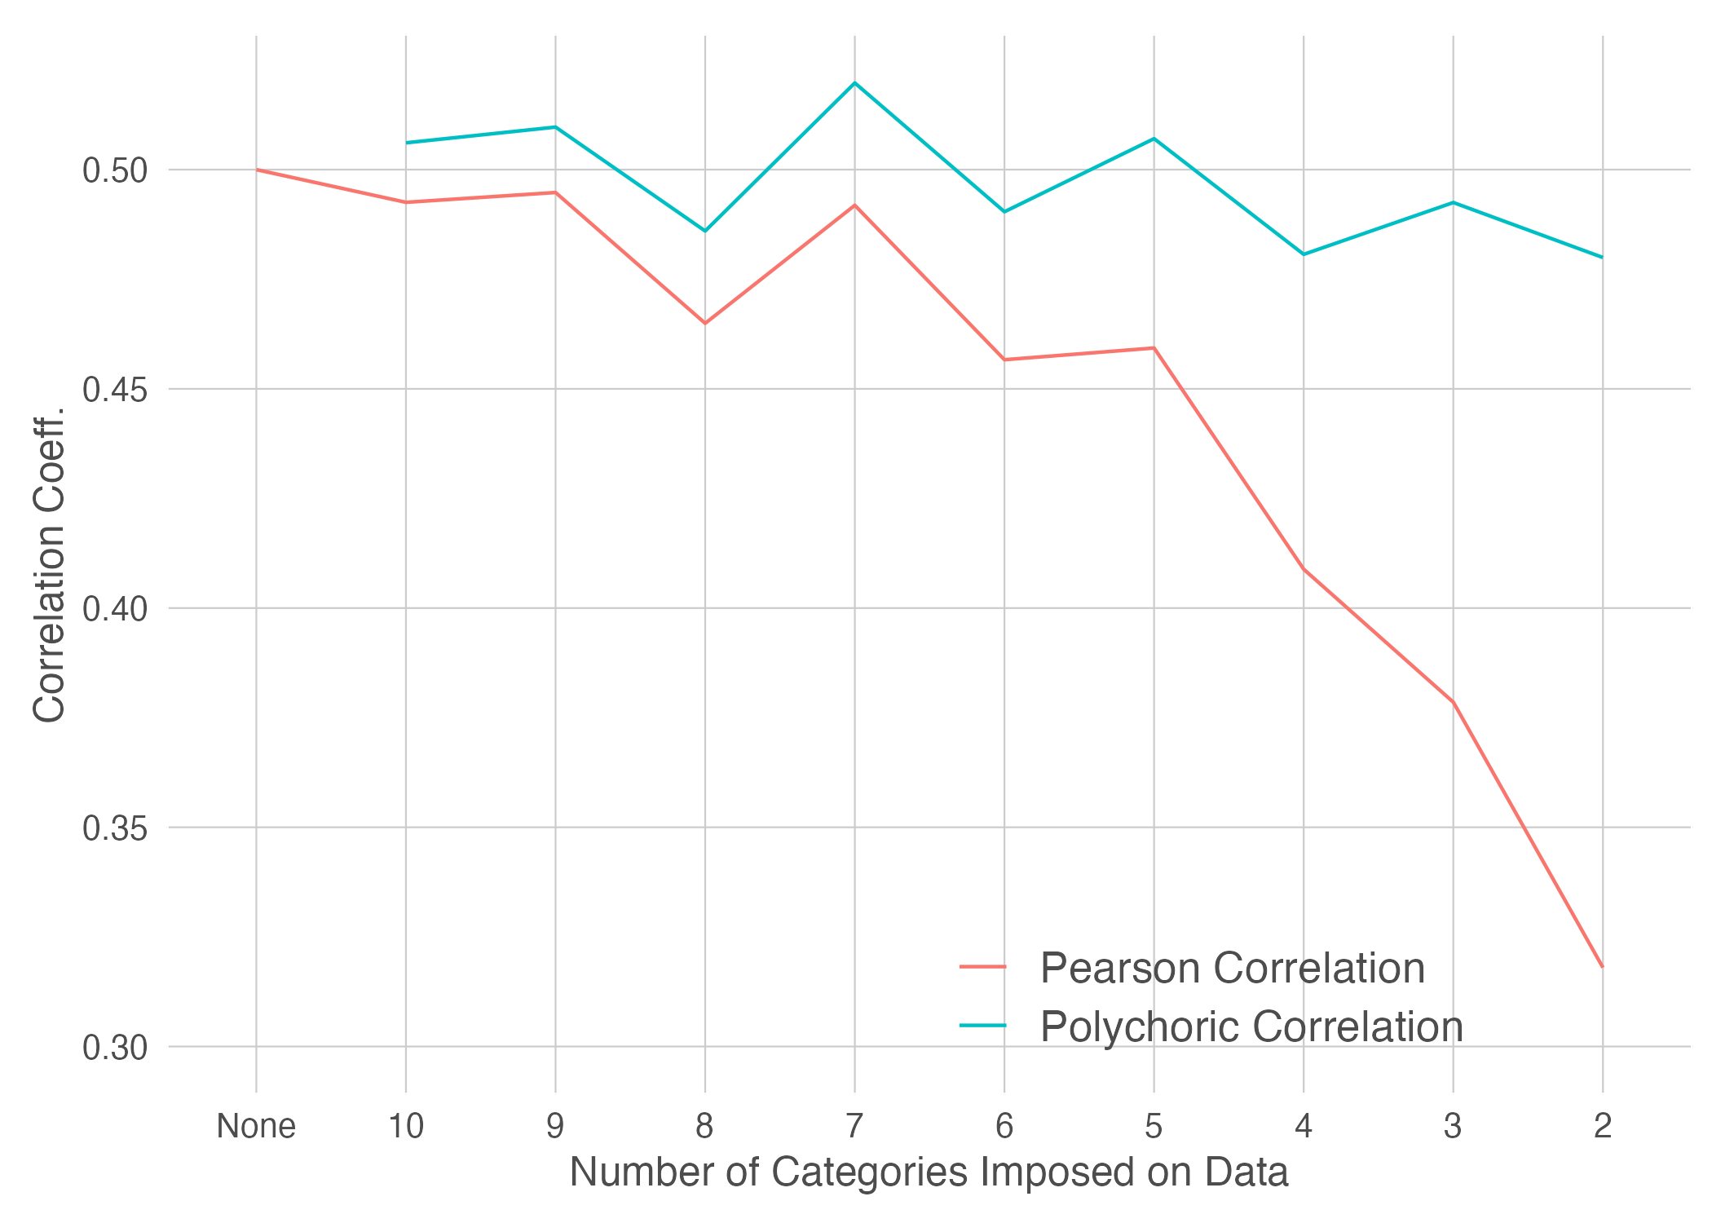
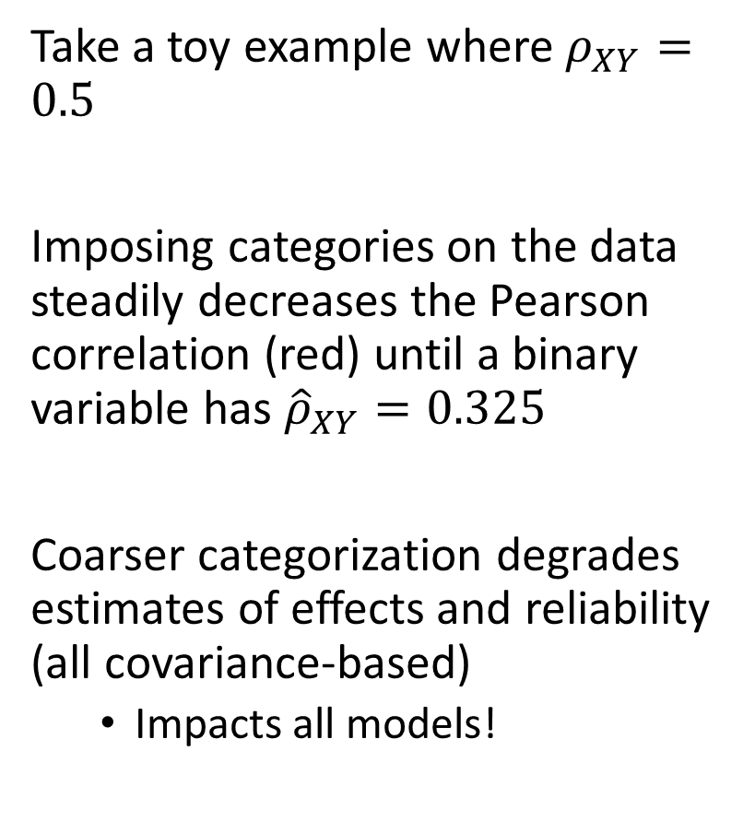
Coarse Categorization
Take a toy example where $ρ_{XY}=0.5$
Imposing categories on the data steadily decreases the Pearson correlation (red) until a binary variable has ${\hat{ρ}}_{XY}=0.325$
Coarser categorization degrades estimates of effects and reliability (all covariance-based)
Impacts all models!

Slide 52
PCA and Factor Analysis

Slide 53
Aim: Uncovering Dimensionality
A key consideration in the construction of a test is whether the items measure a single, unidimensional construct, or if there is multi-dimensionality.
Historically, unidimensionality is the goal because it aids in the calculation of true score variance and reliability
Multidimensionality is OK, as long as we know which items measure which attribute
In real data, it is difficult to know the dimensionality of your items
Can use a variety of techniques to uncover “hidden” dimensionality
Include both model-free (PCA) and model-based (factor analysis) methods

Slide 54
Principal Components Analysis

Slide 55
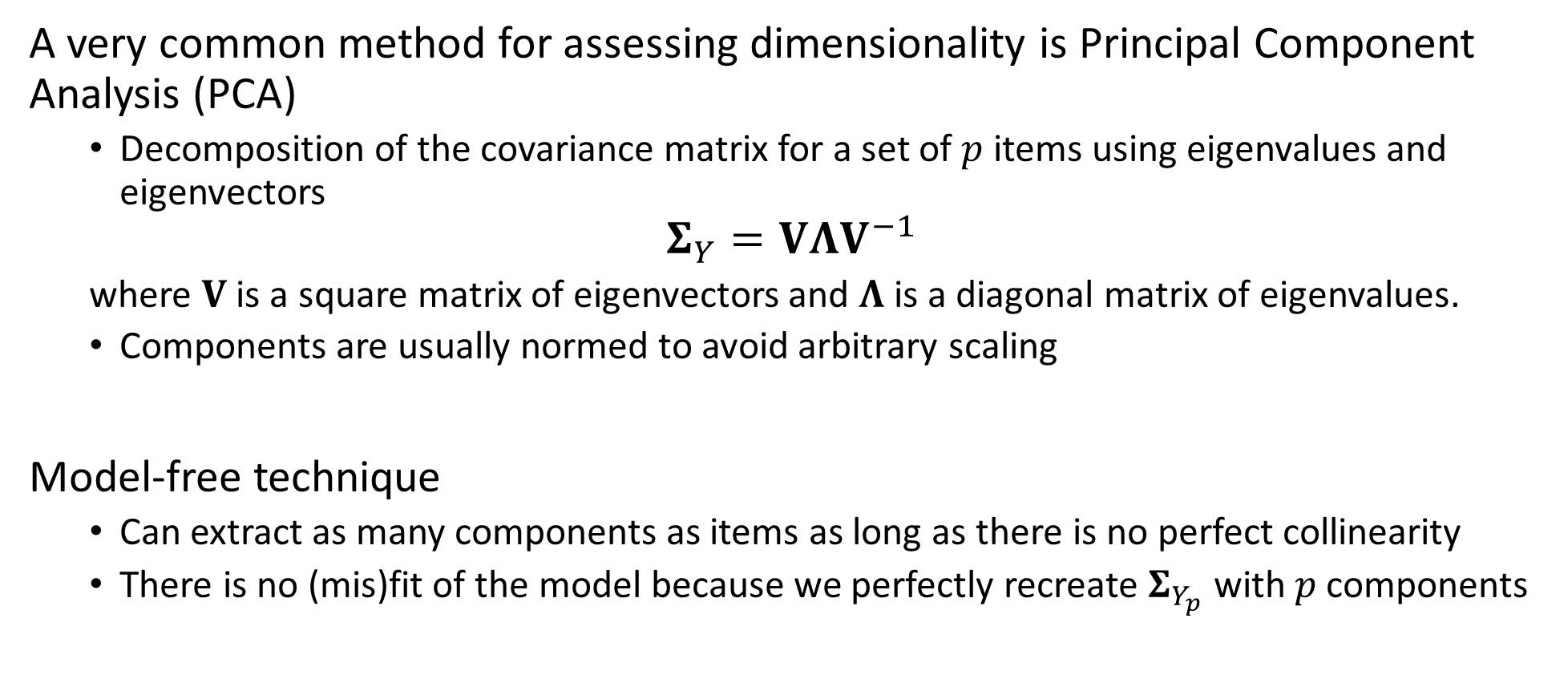
Principal Components Analysis
A very common method for assessing dimensionality is Principal Component Analysis (PCA)
Decomposition of the covariance matrix for a set of $p$ items using eigenvalues and eigenvectors
$$Σ_{Y}=VΛV^{−1}$$
where $V$ is a square matrix of eigenvectors and $Λ$ is a diagonal matrix of eigenvalues.
Components are usually normed to avoid arbitrary scaling
Model-free technique
Can extract as many components as items as long as there is no perfect collinearity
There is no (mis)fit of the model because we perfectly recreate $Σ_{Y_{p}}$ with $p$ components

Slide 56
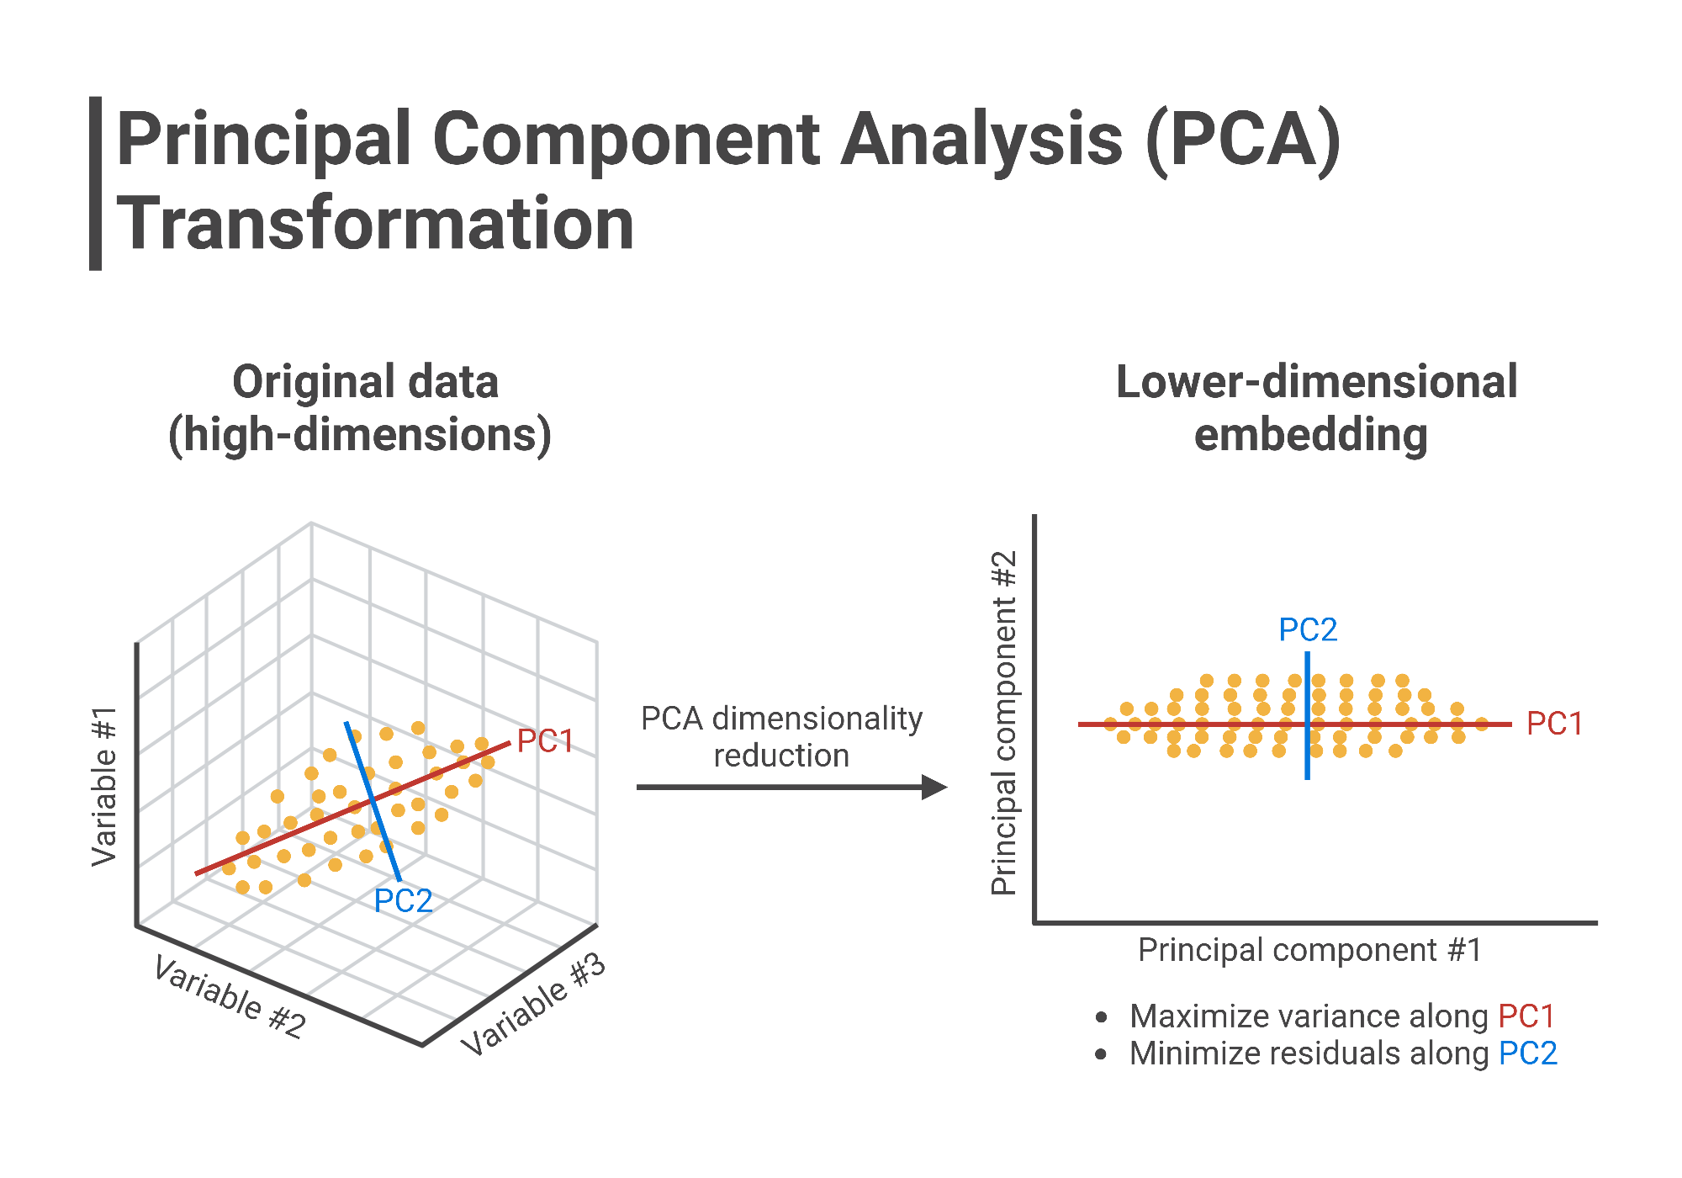
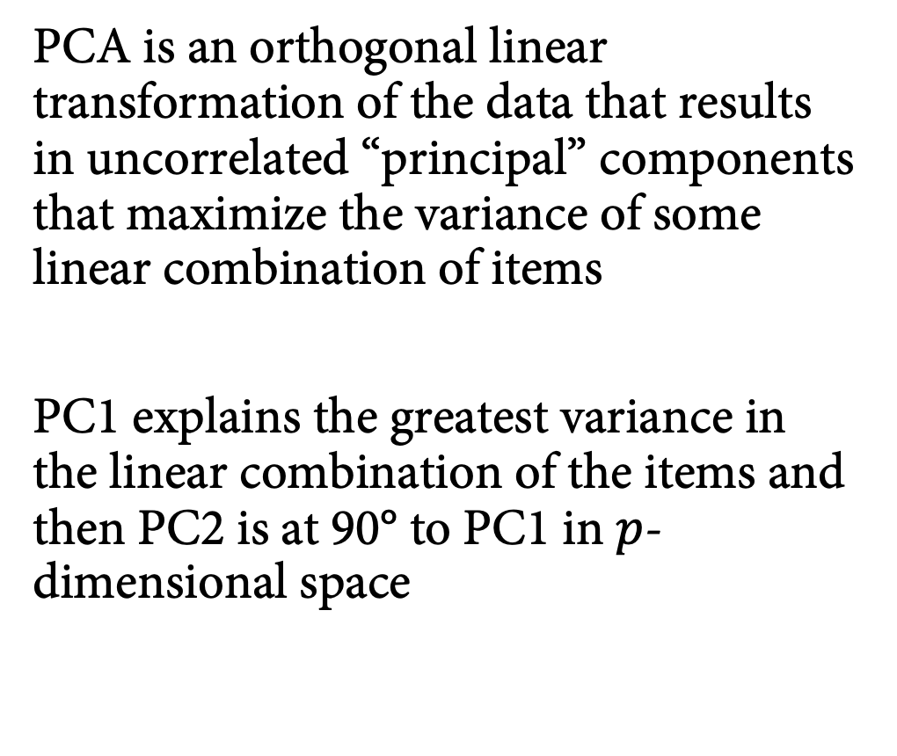
Principal Components Analysis
PCA is an orthogonal linear transformation of the data that results in uncorrelated “principal” components that maximize the variance of some linear combination of items
PC1 explains the greatest variance in the linear combination of the items and then PC2 is at 90° to PC1 in $p$-dimensional space

Slide 57
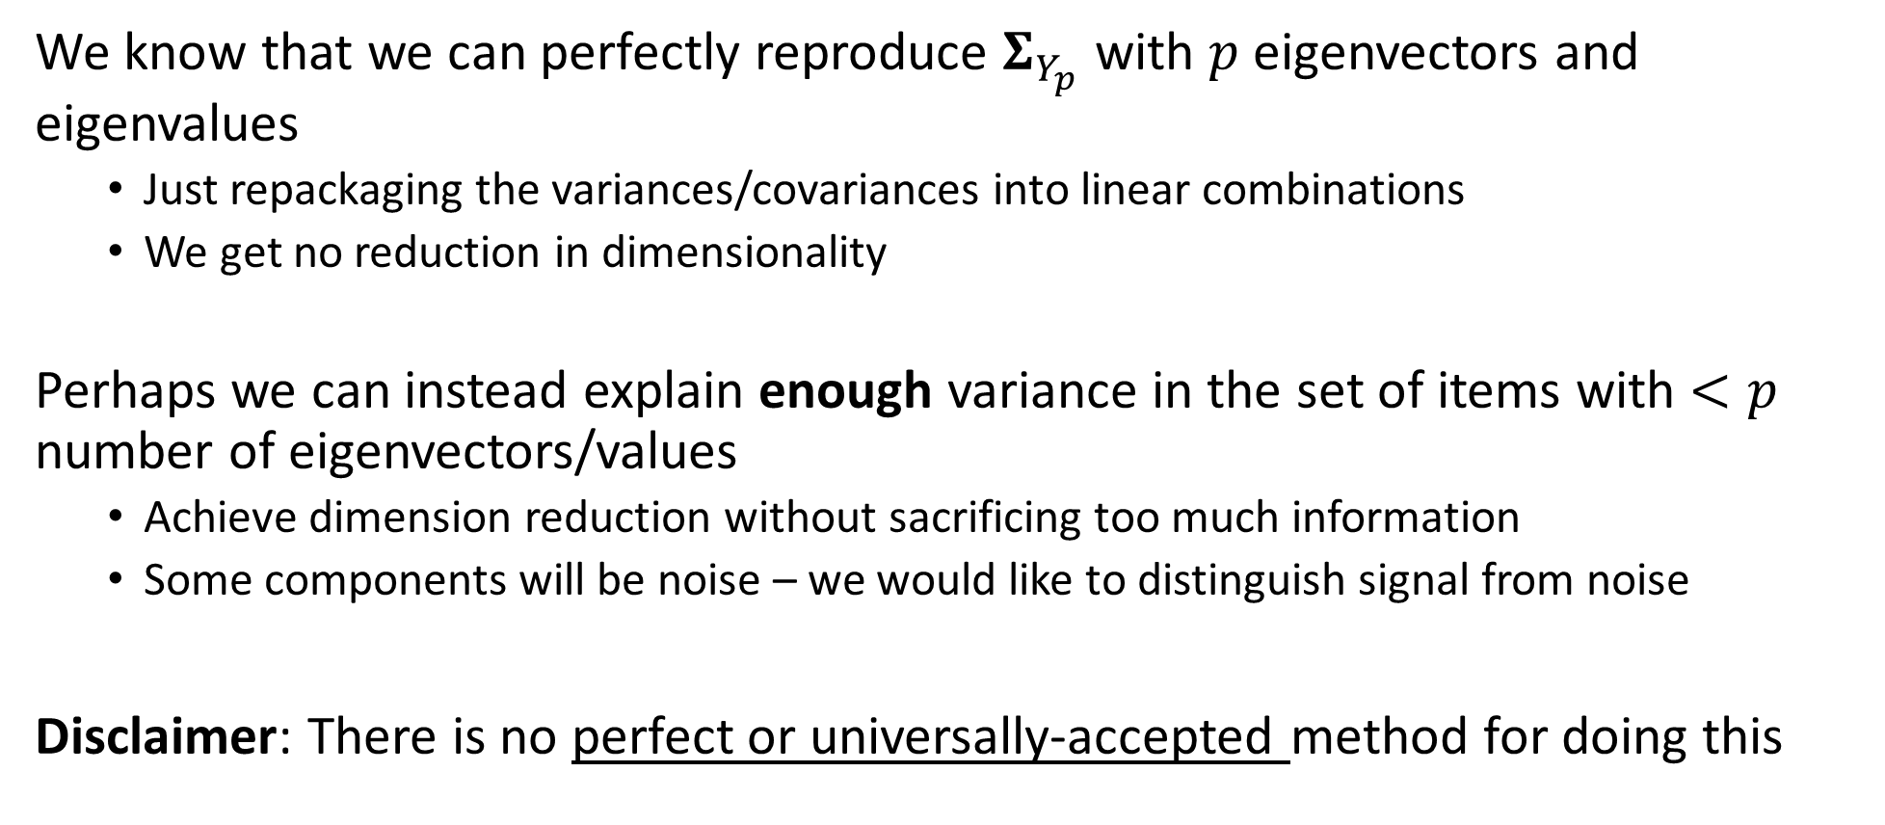
Dilemma of PCA
We know that we can perfectly reproduce $Σ_{Y_{p}}$ with $p$ eigenvectors and eigenvalues
Just repackaging the variances/covariances into linear combinations
We get no reduction in dimensionality
Perhaps we can instead explain enough variance in the set of items with $<p$ number of eigenvectors/values
Achieve dimension reduction without sacrificing too much information
Some components will be noise – we would like to distinguish signal from noise
Disclaimer: There is no perfect or universally-accepted method for doing this

Slide 58
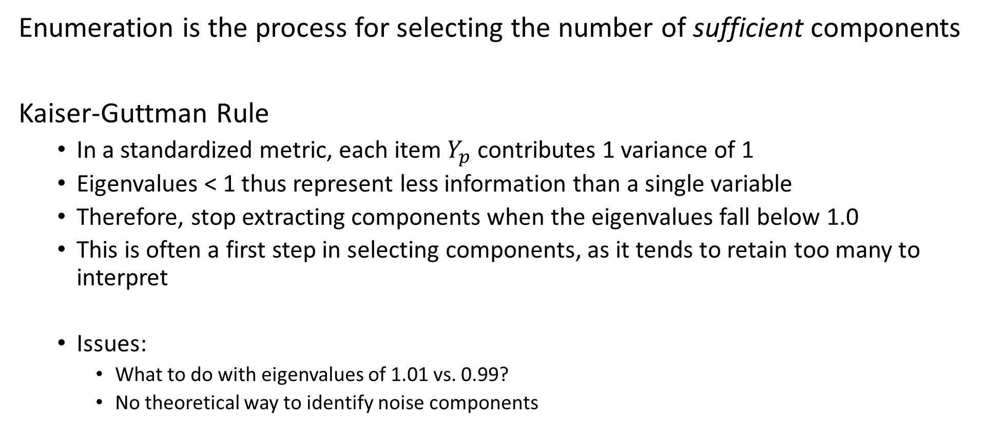
Enumeration
Enumeration is the process for selecting the number of sufficient components
Kaiser-Guttman Rule
In a standardized metric, each item $Y_{p}$ contributes 1 variance of 1
Eigenvalues < 1 thus represent less information than a single variable
Therefore, stop extracting components when the eigenvalues fall below 1.0
This is often a first step in selecting components, as it tends to retain too many to interpret
Issues:
What to do with eigenvalues of 1.01 vs. 0.99?
No theoretical way to identify noise components

Slide 59
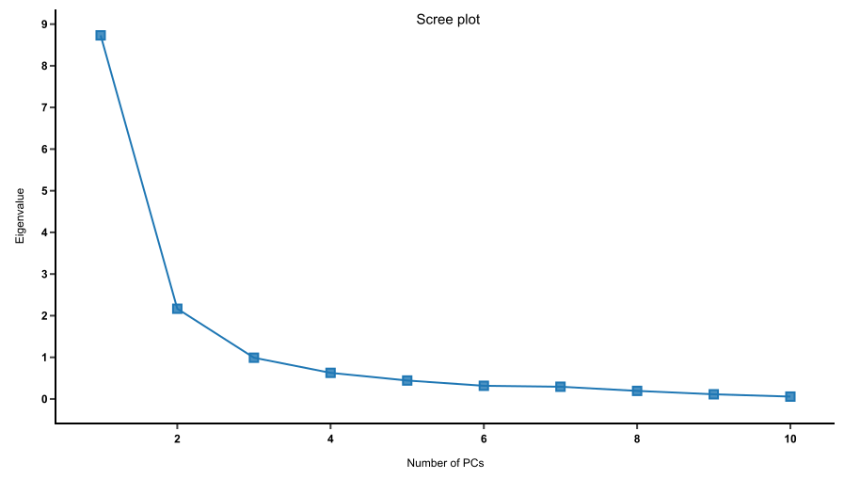
Enumeration
Enumeration is the process for selecting the number of sufficient components
Graphical rule
Look for “bend” in scree plot
PCs before bend are retained
Often combined with KG rule and
multiple solutions compared
Issues
Bend is not always obvious
Do we retain marginal PCs?
Still no way to identify noise
Bend

Slide 60
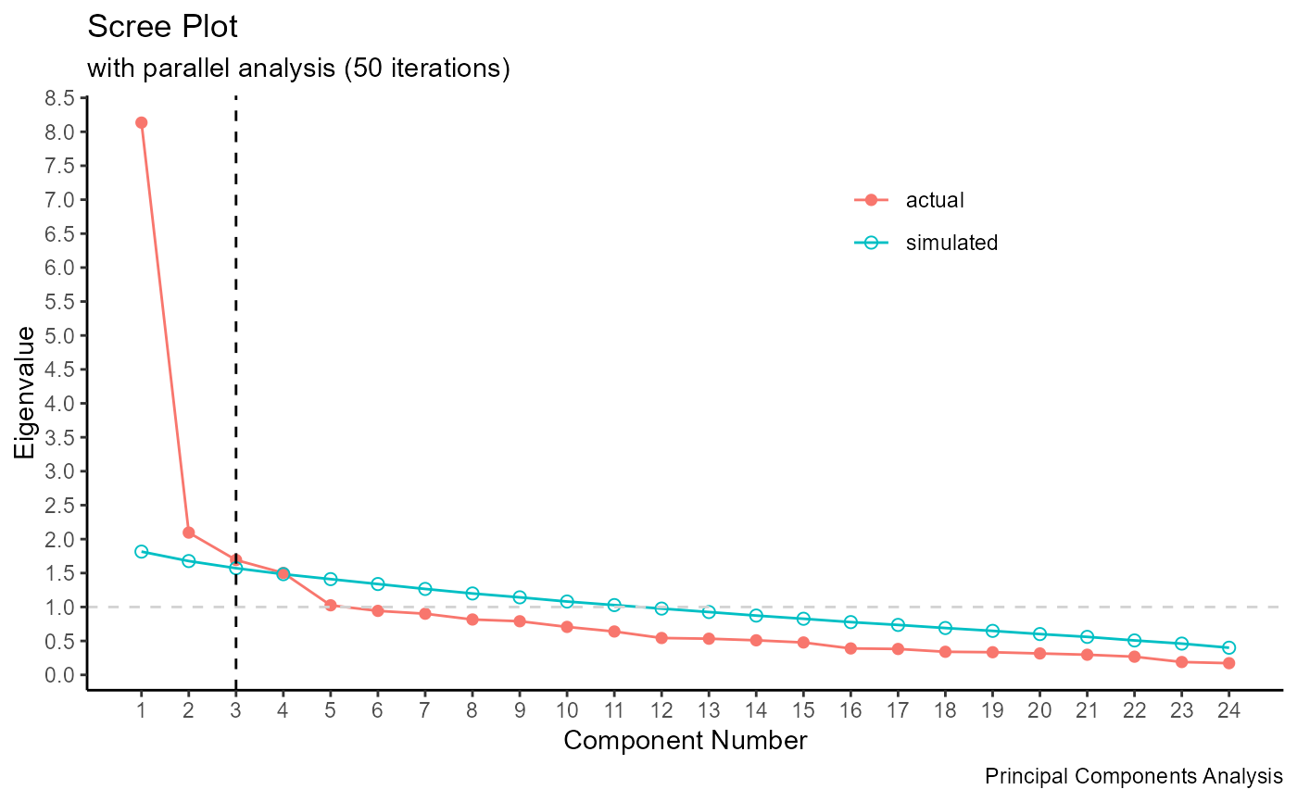
Enumeration
Enumeration is the process for selecting the number of sufficient components
Parallel Analysis
Augment scree plot with same
PC extraction on random data
Only retain PCs which have a higher
eigenvalue than the same
PC in the random data

Slide 61
Enumeration
Enumeration is the process for selecting the number of sufficient components
Interpretatability
There is no guarantee that these rule may lead to a definitive number of components
Sometimes rules will conflict with one another
Two solutions might differ in their interpretability
Number of dimensions
Pattern of items related to principal components
“Substantial” variance explained

Slide 62
Enumeration: Summary
Kaiser-Guttman Rule: Eigenvalues > 1
Scree plot: Identify “bend” in PC plot and select factors above it
Parallel analysis: Select number of PCs in real data with eigens above that of random data
Interpretability: More subjective, inspect content of items to evaluate what they have in common. Retain factor if they seem to cover a meaningful, unidimensional (psychological) construct

Slide 63
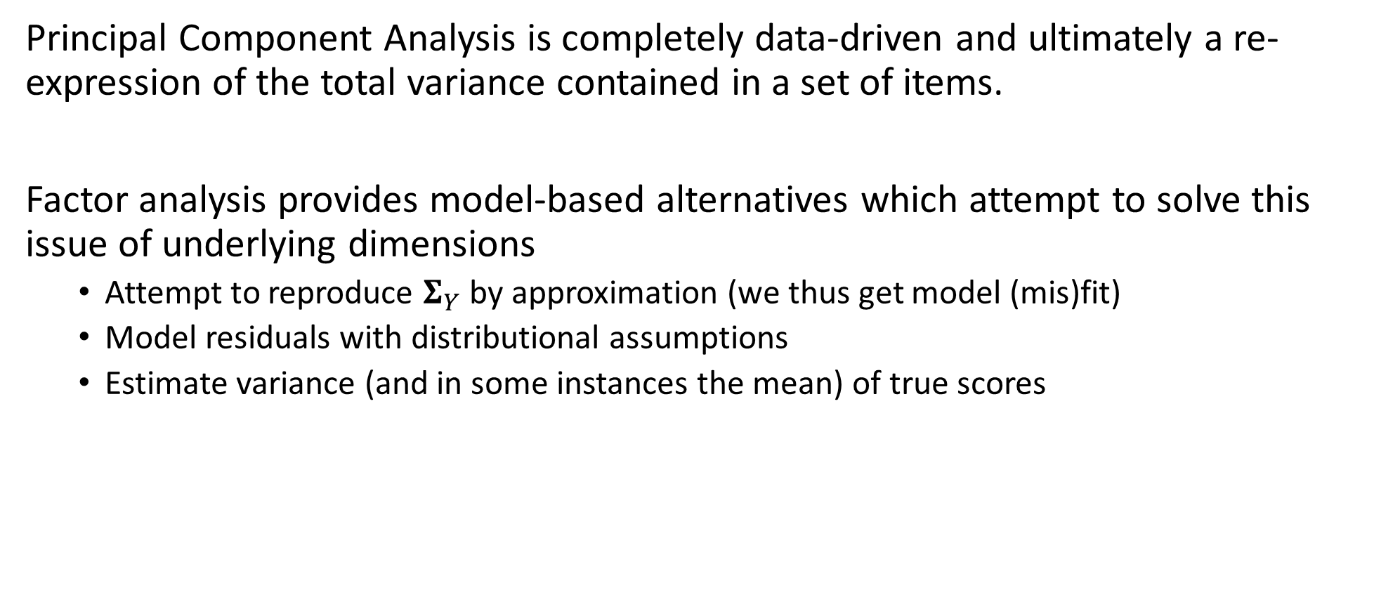
Model-Free versus Model-based
Principal Component Analysis is completely data-driven and ultimately a re-expression of the total variance contained in a set of items.
Factor analysis provides model-based alternatives which attempt to solve this issue of underlying dimensions
Attempt to reproduce $Σ_{Y}$ by approximation (we thus get model (mis)fit)
Model residuals with distributional assumptions
Estimate variance (and in some instances the mean) of true scores

Slide 64
Factor Analysis

Slide 65
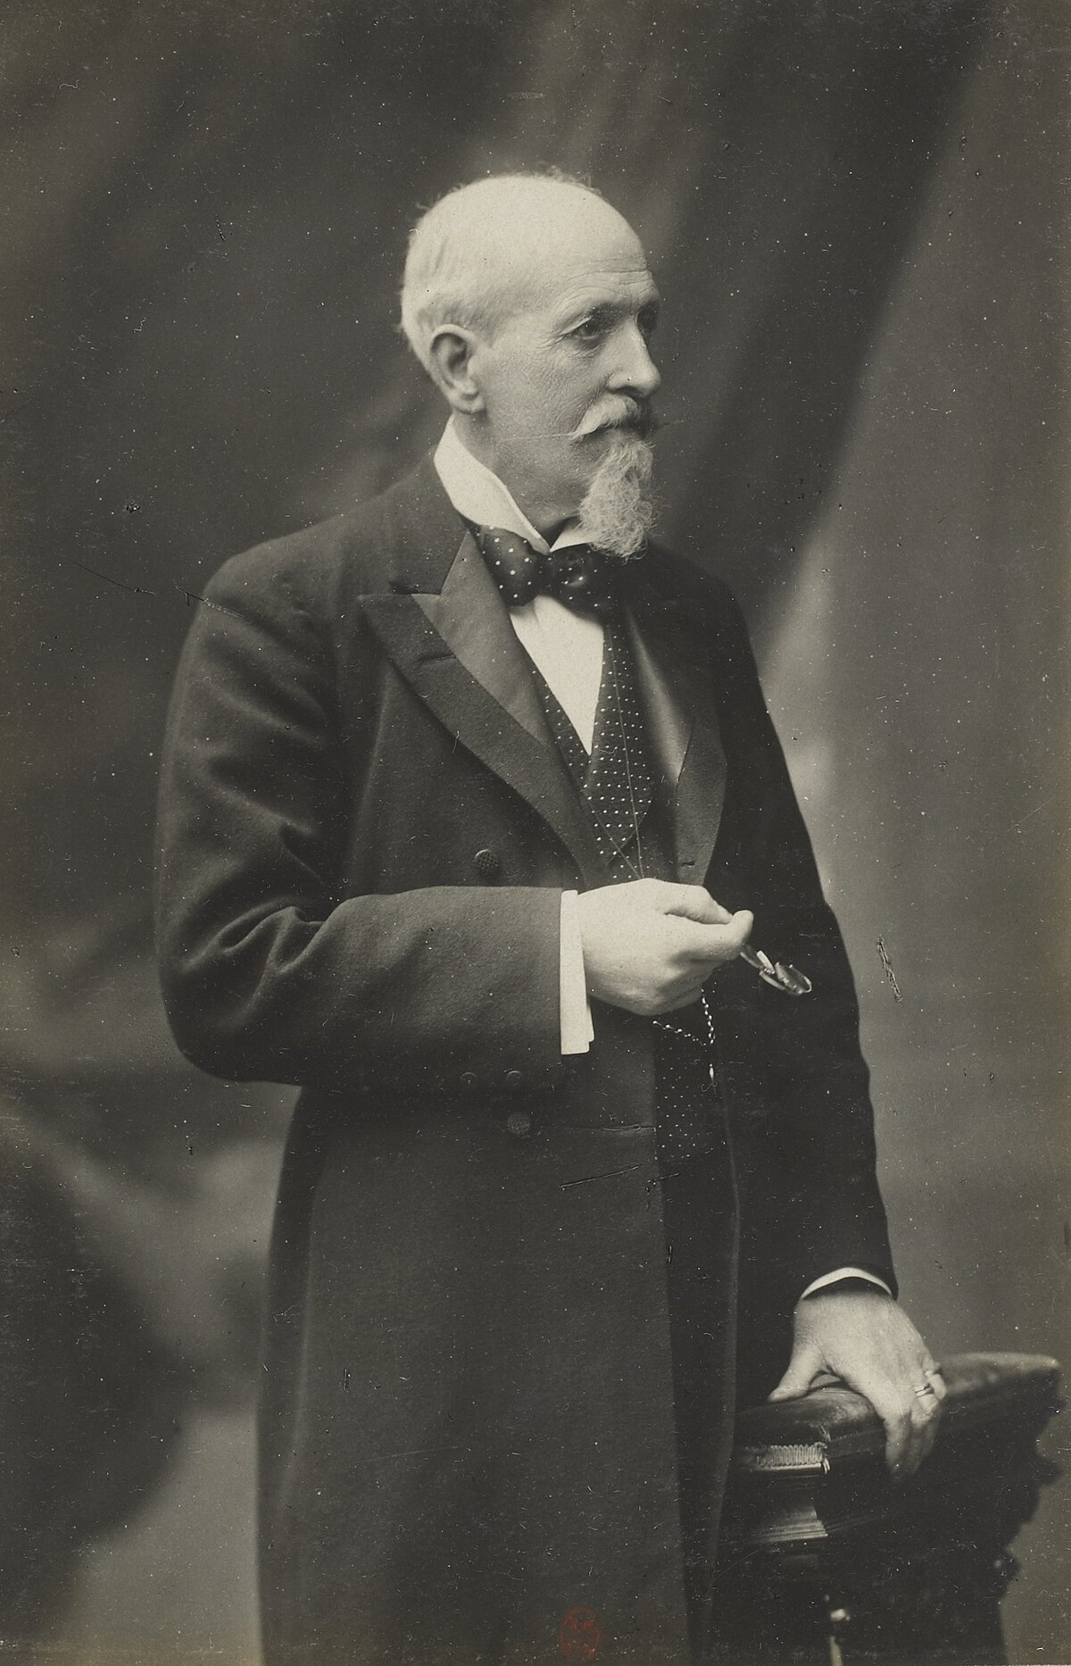
The History of Factor Analysis
“…...we reach the profoundly important conclusion that there really exists a something that we may provisionally term “General Sensory Discrimination” and similarly a “General Intelligence” and further that the functional correspondence between these two is not appreciably less than absolute. (Italics in the original.)
(Spearman, 1904)”

Slide 66

The History of Factor Analysis
Many of the cruxes of factor analysis are contained in this quotation
“that there really exists a something that we may provisionally term “General Sensory Discrimination” and similarly a “General Intelligence”
The existent general attributes – a.k.a. factor or latent variables – that we are not able to directly observe
Labels of these factors are provisional
the functional correspondence between these two is not appreciably less than absolute
These unobserved dimensions may be related to some degree
Spearman thought they were correlated at $ρ=1$ (or really that they collapsed into a single dimension), but later work by Thurstone (1935; Vectors of the Mind) considered factors that were correlated at $\left|ρ\right|<1$

Slide 67

Latent Variables in Factor Analysis
In PCA we talk about components, in factor analysis we talk about latent variables or “factors”
Latent variables are conceptualized as the unobserved common cause of a set of item responses
Explain the correlations between sets of items (remember our definition of $σ_{T}^{2}$)
Once we regress out this unobserved variable, we have a condition of “local independence”

Slide 68

The Factor Analytic Model
Taking a vector of observed item responses $y$ for person $i$, the factor analytic model considers a function of item intercepts ($ν$), the weighted ($Λ$) contribution of the unobserved latent variable ($η$), and Gaussian-distributed error terms ($ε$) with covariance $Θ$
$y_{i}=ν+Λη_{i}+ε_{i}$ $ε_{i}∼MVN(0,Θ)$
Importantly, we also write an equation for the unobserved latent variable with a mean ($α$) and multivariate Gaussian-distributed disturbance ($ζ$; analogous to a variance or residual depending on the model) with a covariance matrix $Ψ$
$η_{i}=α+ζ_{i}$ $ζ_{i}∼MVN(vec\left(0\right),Ψ)$

Slide 69
















The Factor Analytic Model: Path Model
$${ ε}_{1}$$
$${ ε}_{2}$$
$${ ε}_{3}$$
$${ ε}_{4}$$
$${ ε}_{5}$$
Residuals (unique factors) $ε_{j}$
$$y_{1}$$
$$y_{2}$$
$$y_{3}$$
$$y_{4}$$
$$y_{5}$$
Observed item respones $y_{j}$
Factor loadings $Λ_{jk}$
$${ η}_{1}$$
$${ η}_{2}$$
Latent variables
(common factors) $η_{k}$

Slide 70
Exploratory Factor Analysis
While methodologically distinct, Exploratory Factor Analysis (EFA) shares many of the same goals and approaches as PCA
Determine the number and nature of a set of lower-dimensional components (or factors) that explains “enough” of the variation in a set of items
How do we choose the number of factors?
The biggest difference is now we partition variance into two sources
Common variance: captured by the latent factors
Unique variance: captured by the item residuals (noise/measurement error)
The unique factors (residuals) allow us to get measures of fit

Slide 71

Exploratory Factor Analysis
Procedurally, very similar to PCA
Select the number of factors and fit the model
Examine fit indices (this is different)
Examine the proportion of variance explained by the common factor (scree plot, parallel analysis)
Refit the model based on the indicated number of factors as needed
Substantive interpretation

Slide 72

Fit Measures in Factor Analysis
A wide range of fit measures have been developed in factor analysis to assess whether the factor model reproduces the observed data well
Most are based on the $χ^{2}$ test of fit ($T$):
$χ^{2}$ value quantifies the difference between observed (sample) covariance matrix $S$ and model-implied (population) covariance matrix $\hat{Σ}$
$χ^{2}=0$ implies perfect model fit; the larger the difference between $\hat{Σ}$and $S$, the larger the $χ^{2}$
This test statistic follows a $χ^{2}$ distribution with degrees of freedom for $p$ items and $m$ common factors given by:
$$df_{T}={\left(p−m\right)}^{2}−\frac{p−m}{2}$$
A significant test statistic indicates that our model fits significantly worse than we would expect by chance
Tends to be over-powered (higher chance of false positives, especially at large N)
Other measures will be covered in SEM topics

Slide 73

Exploratory Factor Analysis
In EFA, all observed items are allowed to “load” on all common factors
$Λ$ matrix is saturated with association estimated between each factor and each item
Factor means are set to zero and factor variances set to 1 (unobserved metrics have no natural scale)
And yet…we would like each item to load primarily on only a single factor
High factor loadings (rule of thumb > 0.2 or 0.3 or 0.4) for one $η_{m}$ and low loadings on all others
Known as “simple structure”
To achieve simple structure, factor loadings are rotated using a wide variety of methods that fall into two broad categories: orthogonal (uncorrelated factors) and oblique (correlated factors)

Slide 74

Confirmatory Factor Analysis
EFA is similar to PCA in that it is data-driven. It is therefore difficult to use it for testing theoretical hypotheses.
Confirmatory Factor Analysis (CFA) allows to specify a hypothesis on the number of factors in $η$ as well as the pattern of zero and non-zero loading in $Λ$, such that items only load onto a single factor in a theoretically-meaningful way.

Slide 75
Confirmatory Factor Analysis
Exploratory Factor Analysis
Confirmatory Factor Analysis

Slide 76









Confirmatory Factor Analysis
The same equations describe the CFA
Zero elements in $Λ$
$$\left[\begin{matrix}λ_{11} & 0 \\ λ_{21} & 0 \\ λ_{31} & 0 \\ 0 & λ_{42} \\ 0 & λ_{52}\end{matrix}\right]$$
Confirmatory Factor Analysis
$y_{i}=ν+Λη_{i}+ε_{i}$ $ε_{i}∼MVN(0,Θ)$
$η_{i}=α+ζ_{i}$ $ζ_{i}∼MVN(vec\left(0\right),Ψ)$
$$λ_{21}$$
$$λ_{11}$$
$$λ_{31}$$
$$λ_{42}$$
$$λ_{52}$$
$$α_{1}=0$$
$$ψ_{11}$$
$$α_{2}=0$$
$$ψ_{22}$$
$$ψ_{21}$$

Slide 77

Confirmatory Factor Analysis
Factor analysis technique for testing an a-priori specified measurement structure on a set of observed items
The number of factors and which items load onto each are pre-determined
Can test the fit of the model to the data to assess whether the pre-specified fits the data well
$χ^{2}$ test statistic (other fit indices such as CFI/TLI, RMSEA)
Model comparison between a set of hypothesized models
We will return to CFA in more detail when we cover the general structural equation model

Slide 78
Factor-based Classical Test Theory

Slide 79
Classical Test Theory as Factor Analysis
You may have noticed similarities between the CFA model and our conceptual diagram for understanding true score and error variance in CTT
We use one-factor CFA as a way to understand classical test theory

Slide 80























Classical Test Theory as Factor Analysis
Rather than $Y=T+E$, we have $y=ν+λη+ε$
Constrain factor mean $α$=0 and factor variance $ψ$= 1
Residuals have variance $θ$
Item means:
$$E\left(y_{p}\right)=ν+λ_{p}η$$
Item variances:
$$Var\left(y_{p}\right)=λ_{p}^{2}ψ+θ_{p}=λ_{p}^{2}+θ_{p}$$
Item covariances:
$$Cov\left(y_{p}, y_{q}\right)=λ_{p}ψλ_{q}$$
$$θ_{1}$$
$$θ_{2}$$
$$θ_{3}$$
$$θ_{4}$$
$$θ_{5}$$
$${ ε}_{1}$$
$${ ε}_{2}$$
$${ ε}_{3}$$
$${ ε}_{4}$$
$${ ε}_{5}$$
$$y_{1}$$
$$y_{2}$$
$$y_{3}$$
$$y_{4}$$
$$y_{5}$$
$$λ_{2}$$
$$λ_{3}$$
$$λ_{4}$$
$$λ_{1}$$
$$λ_{5}$$
$$η$$
$$α=0$$
$$ψ=1$$

Slide 81

Reliability in Factor Analysis
A factor analytic approach makes calculation of reliability in a one-factor model very easy. Recall that reliability ($ω$ more generally) is the ratio of true score (common) variance to total variance:
$$ω=\frac{σ_{T}^{2}}{σ_{y}^{2}}=\frac{\sum_{p}{λ_{p}^{2}}}{\sum_{p}{λ_{p}^{2}}+\sum_{p}{θ_{p}}}=\frac{{\left(\sum_{p}{λ_{p}}\right)}^{2}}{{\left(\sum_{p}{λ_{p}}\right)}^{2}+\sum_{p}{θ_{p}}}$$
Different versions of reliability fall out of this equation depending on the constraints we include in the factor model. For instance, Cronbach’s alpha is estimated when all factor loadings are equal ($λ_{p}=λ_{q}, ∀ p,q$)
Other reliability scores relax this assumption

Slide 82

Types of Reliability Models
A congeneric test does not impose constraints on $λ$, $θ$, or $ν$
Only the general structure of the one factor model is imposed – McDonald’s $ω$
A tau-equivalent test is one where items are true-score equivalent – or reflect the latent variable equally
This implies that $λ_{p}=λ_{q}, ∀ p,q$ – the assumption of $α$
A parallel test is one where items are true-score and error equivalent
This implies that $λ_{p}=λ_{q}$ and $θ_{p}=θ_{q}, ∀ p,q$
A strictly parallel test is where items are essentially identical (very rare)
$ν_{p}=ν_{q}$, $λ_{p}=λ_{q}$, and $θ_{p}=θ_{q}, ∀ p,q$

Slide 83

Reliability and Test Lengthening
Increasing the length of a test tends to increase reliability, especially if additional items reflect the latent variable similarly.
For $r$ times more items and constraining $ψ=1$
$$ω=\frac{{\left(r\sum_{p}{λ_{p}}\right)}^{2}}{{\left(r\sum_{p}{λ_{p}}\right)}^{2}+r\sum_{p}{θ_{p}}}=\frac{{r^{2}\left(\sum_{p}{λ_{p}}\right)}^{2}}{{r^{2}\left(\sum_{p}{λ_{p}}\right)}^{2}+r\sum_{p}{θ_{p}}}$$
The true score component increases quadratically (if all $λ$ > 0), while the error component only increases linearly!

Slide 84

Lengthening a Test to Achieve a Desired $ω$
With parallel items ($λ_{p}=λ_{q}=λ$ and $θ_{p}=θ_{q}=θ, ∀ p,q$), we can compute the number of items ($r$) that will give us a desired $ω$ because we know that for every item
$ω=ω_{p}=\frac{λ^{2}}{λ^{2}+θ}$ and $1−ω=1−ω_{p}=\frac{θ}{λ^{2}+θ}$
So for $r$ times more items:
$$ω_{r}=\frac{{(rλ)}^{2}}{{\left(rλ\right)}^{2}+rθ}=…=\frac{rω}{1+\left(r−1\right)ω}$$
And to calculate $r$:
$$r=\frac{{ω_{r}}/{(1−ω_{r})}}{ω/{(1−ω)}}=\frac{{ω_{desired}}/{(1−ω_{desired})}}{{ω_{current}}/{(1−ω_{current})}}$$
See Spearman, 1910 for details

Slide 85

Next
Item Response Theory

